Slide 1
2nd Belarusian Social Business Forum
Prof. Gerd Junne, Minsk, 28 June 2018
City governments
AND
Social enterprises

Slide 2

City of Amsterdam: Action programme Social entrepreneurship 2015-2018
Main lines of action:
1. More data on social enterprises and their impact
2. Strengthen network and conducive environment
3. Public procurement
4. More capital for social enterprises
5. Improved entrepreneurial skills
6. Branding as “social entrepreneurship city”

Slide 3
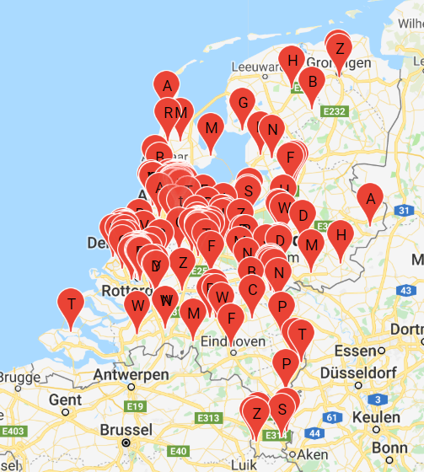
Action line 1: More knowledge about the social entrepreneurship ecosystem
Ca. 1000 social enterprises in Amsterdam
https://www.social-enterprise.nl/wie-doen-het/

Slide 4

Action line 2: Strengthening network and conducive environment for social enterprises
WeMakeThe.City is the largest city festival in Europe. We celebrate urban living whilst addressing important urban issues in the metropolitan region of Amsterdam. How can we make our cities better? How do we make better cities?
20-24 June 2018

Slide 5
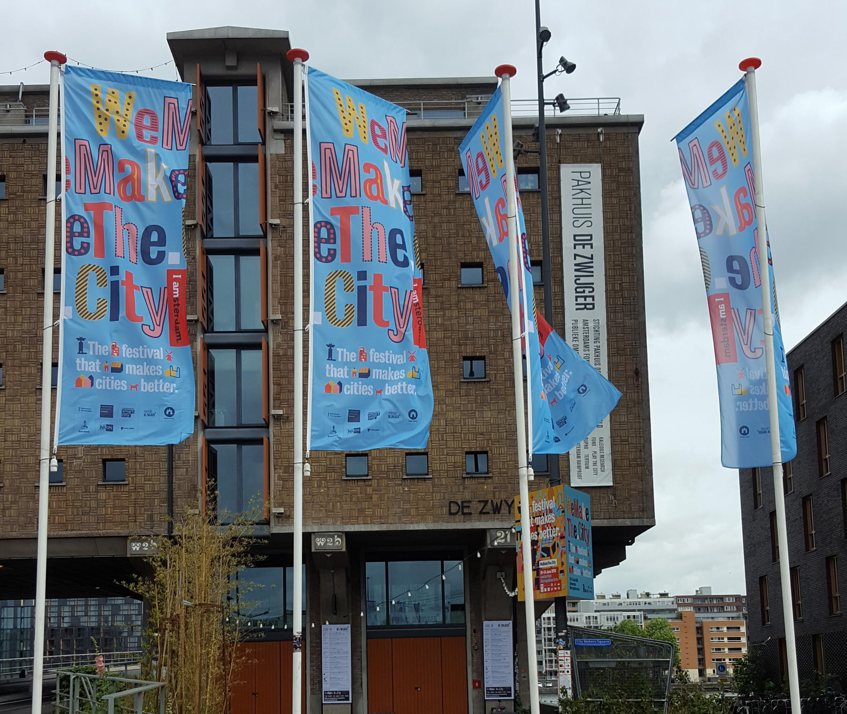
Providing Space

Slide 6
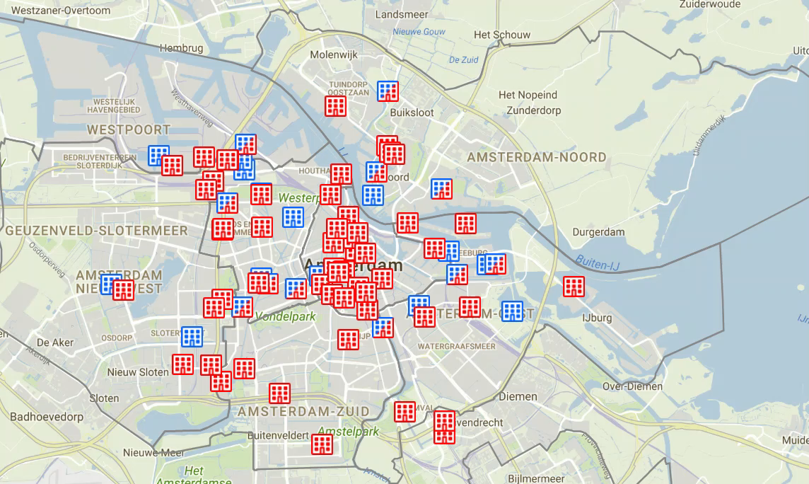
Multitenant buildings for starting companies in Amsterdam

Slide 7
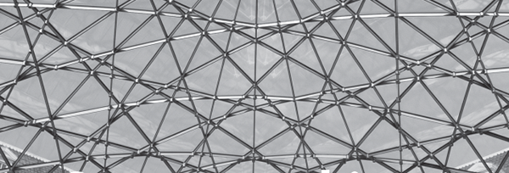
Connecting innovators
amsterdam economic board
made up of leading directors of academic institutions, company CEOs, alderpersons and mayors from the Amsterdam Metropolitan Area. Together they are devising the strategy for the metropolis of the future.

Slide 8
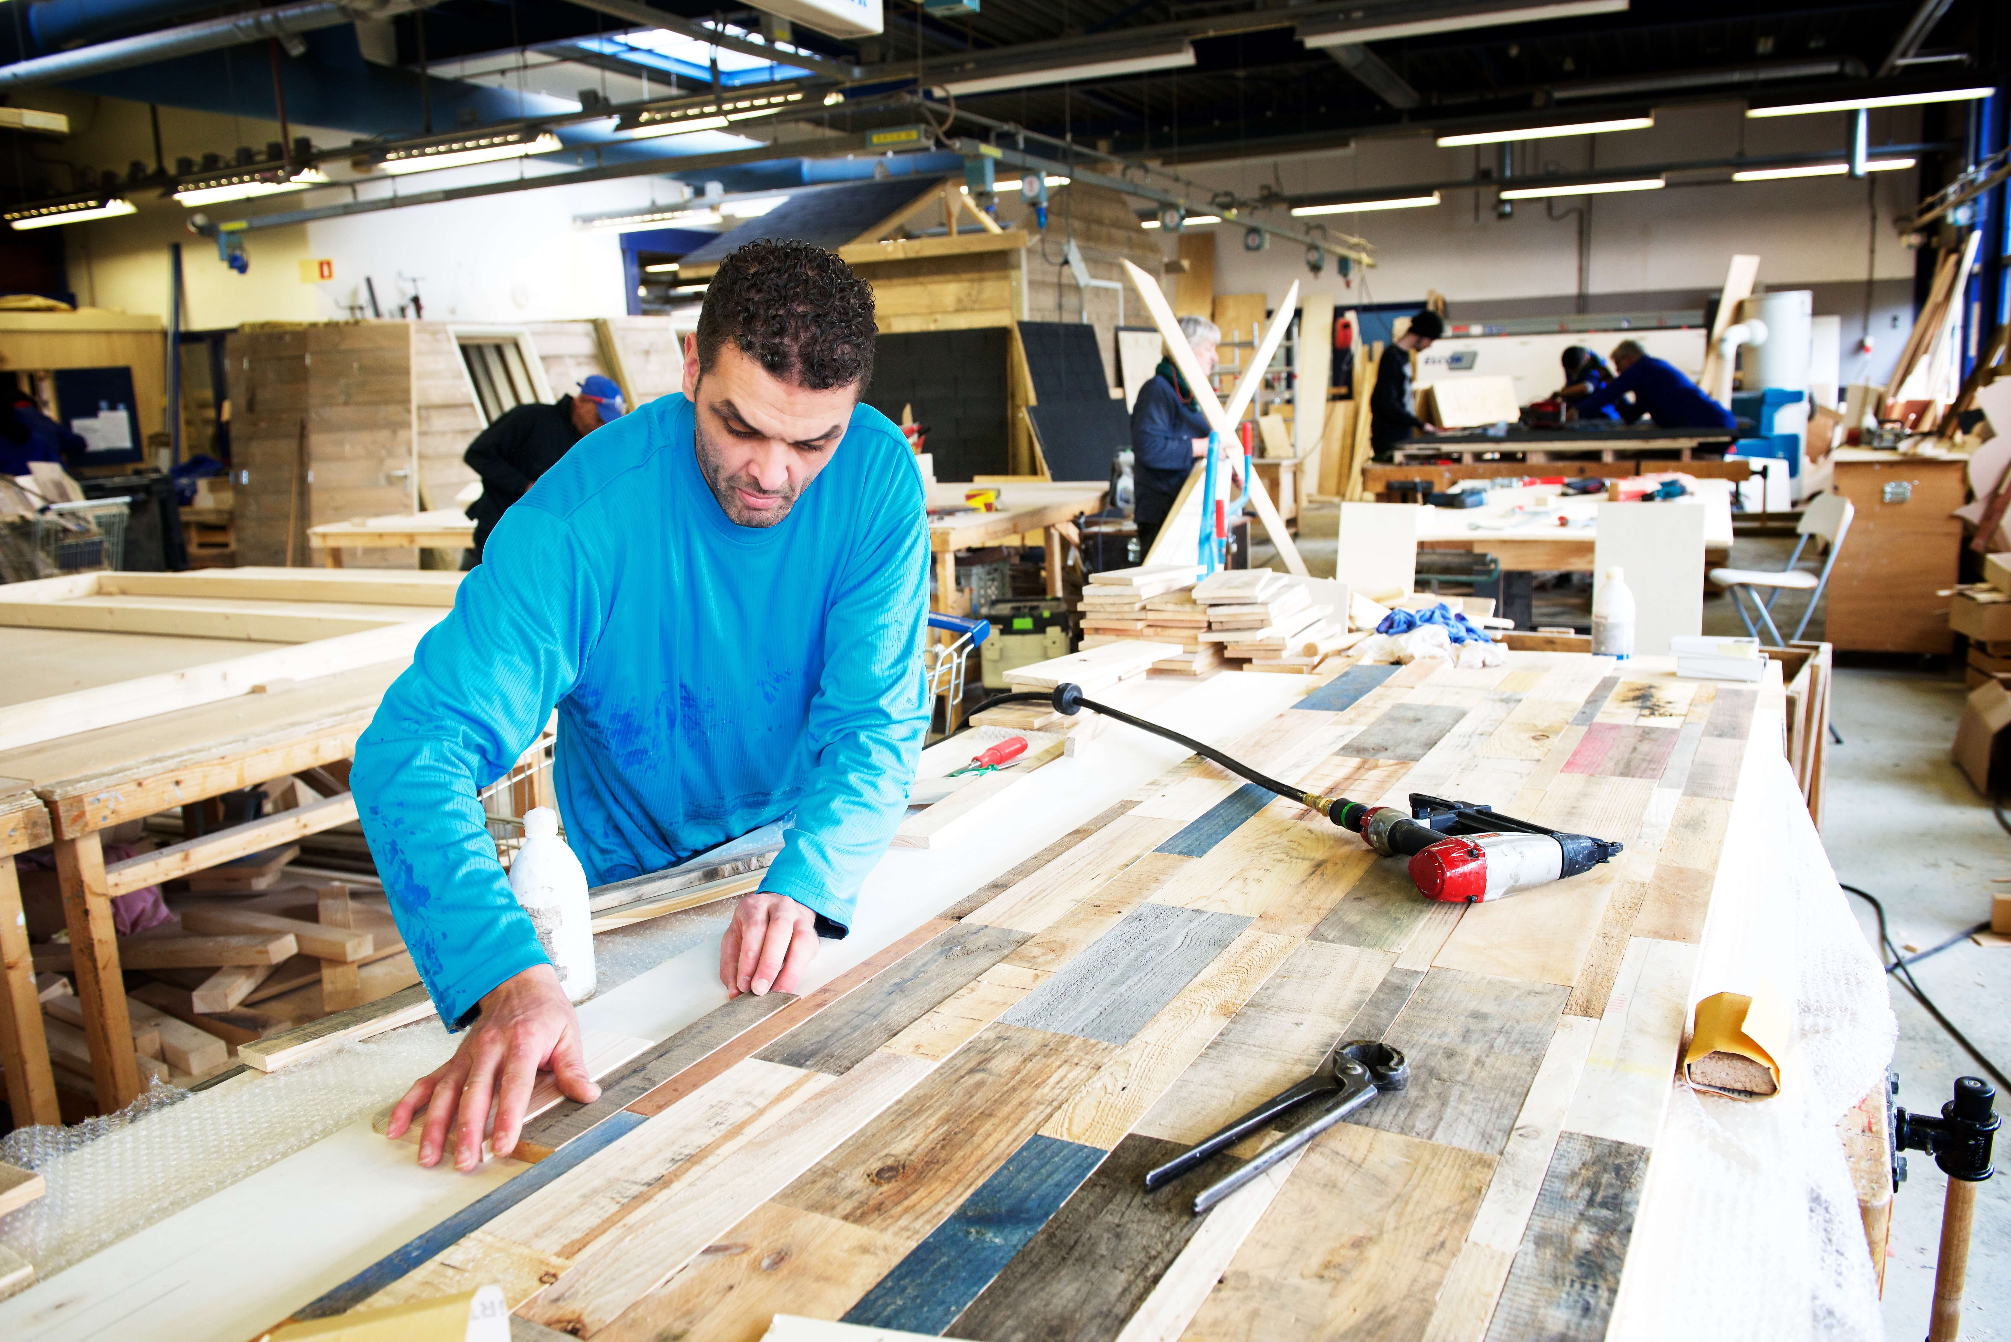
Action line 3:
More procurement from social enterprises
Precondition: new procurement regulation
Lowest cost price no longer the only decicive factor
Instead, social and environmental impact has to be taken into account
This requires some measurement of social impact
Law of 2016 allows to order directly from companies with > 30 % employees with a handicap.

Slide 9

Action line 4:
More capital for social enterprises
Research on a possible Amsterdam Fund for Social Enterprises
Support for participation in European projects
Strengthen connections with financial institutions

Slide 10
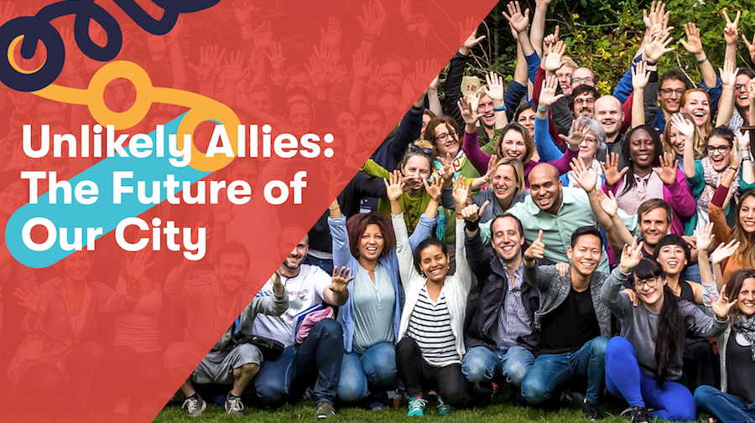
Action line 5: Strengthen entrepreneurial skills
Impact Hub Amsterdam – 10 years anniversary – 22-6-2018

Slide 11
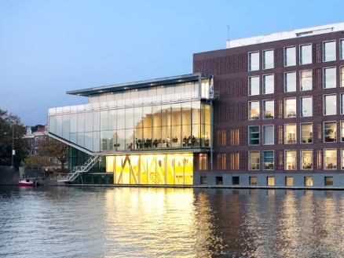

Honoursmodule: Social Entrepreneurship

Slide 12


Slide 13
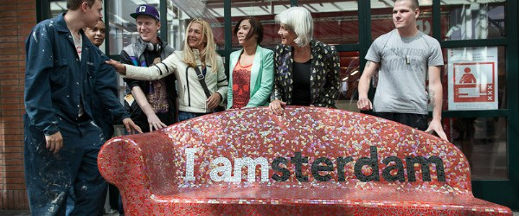
Action line 6: Branding

Slide 14
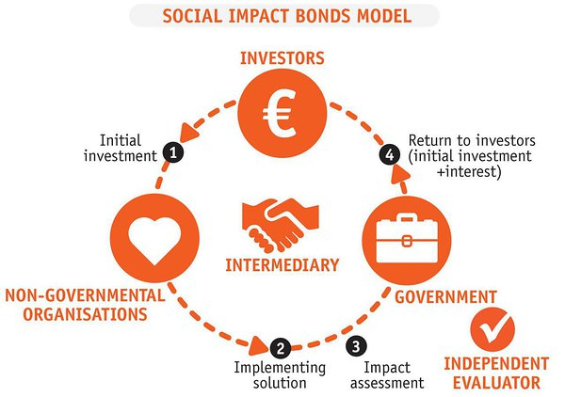
Social Impact Bond - rival Rotterdam
Buzinezzclub trains unemployed youth
If promised success rate is achieved, Rotterdam pays what the city saves on social benefits.

Slide 15


Scaling Up

Slide 16

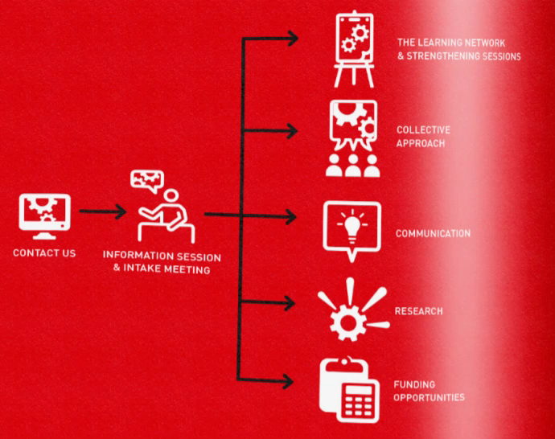



Flemish Government
Agency for Innovation and Enterprises

Slide 17

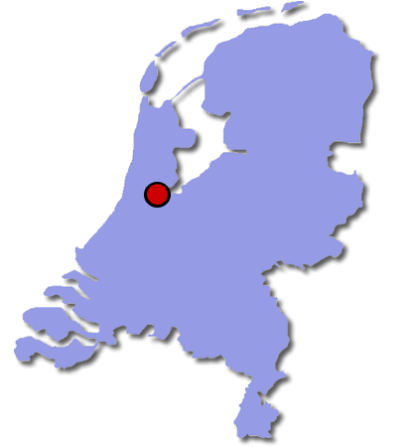
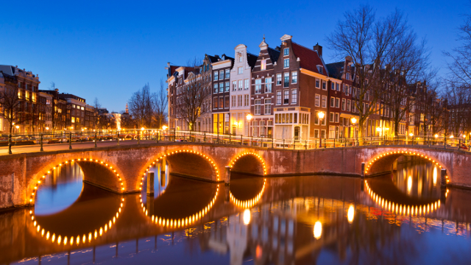
Roundtable discussion on social enterprises in parliament on 25 April 2018
The EU Commission and the expert group on social entrepreneurship established a 5 pillar strategy aimed at increased access to funding, access to markets, improved framework conditions, and foster social innovation.

Slide 18

Summary: What a city can do
Research on social enterprise ecosystem
Initiate & strengthen networks, supporting events
Providing work space (offices, production halls)
Increase procurement from social enterprises
Adapt regulations (e.g. licenses for taxis)
Attract capital to social enterprises
Strengthen entrepreneurial skills
Issue Social Impact Bonds
Use social enterprises as innovators and social laboratory

