Slide 1


ANTI OIL-CURSE
17 January 2013
Who does what already?

Slide 2
International NGO activity
Global Witness
Publish what you pay
Extractive Industries Transparency Initiative
Revenue watch
Open Oil
Voluntary principles
Amnesty International
International Budget Partnership
Stakeholder Democracy Network
ELLA Learning Alliance

Slide 3

1. Global Witness
For 19 years, Global Witness has run pioneering campaigns against natural resource-related conflict and corruption and associated environmental and human rights abuses.
Established in 1993 by three friends, Global Witness now numbers over sixty staff divided between its offices in London and Washington DC.

Slide 4
Unreported off-budget accounts
Top Secret
On the secrecy and misuse of petroleum revenues in Angola, Cambodia, Congo-Brazzaville, Equatorial Guinea, Kazakhstan, and Turkmenistan, see reports by Global Witness: www.globalwitness.org
On Chad and Nigeria, see report by Publish What You Pay: www.publishwhatyoupay.org
M.L.Ross 2012, 59, Note 62

Slide 5
New oil law in South Sudan
Amid reports of endemic corruption, escalating security concerns, and delays restarting crude oil production, South Sudan’s new oil laws offer grounds to be optimistic about the prospects for development and stability, said Global Witness in a report released today.
“South Sudan’s new oil legislation contains strong public reporting, revenue management, and contract allocation requirements,” said Global Witness campaigner Dana Wilkins. “But laws are only as good as their implementation. The real test will be in whether or not the government follows through with these commitments.”
Global Witness Press Release 29-11-2012

Slide 6
Key recommendations by Global Witness
The government should pass the draft Petroleum Revenue Management Bill without delay and ensure that strong provisions for the collection, management, auditing, and public reporting remain intact.
The Ministry of Petroleum and Mining and the Ministry of Finance and Economic Planning should immediately start implementing the requirements for transparent contract allocation, and for the publication of production data, contracts, and quarterly and annual oil revenue management reports.
The government and international donors must ensure that South Sudanese civil society groups, and oversight bodies like the Audit Chamber and parliament, have the resources, access, and technical expertise necessary to carry out effective checks on the oil sector.

Slide 7
2. Publish what you pay
In December 1999 Global Witness published A Crude Awakening, an exposé of the complicity of the oil and banking industries in the plundering of state assets during Angola’s 40-year civil war. The report concluded with a public call on the oil companies operating in Angola to ‘publish what you pay’.
in June 2002 Global Witness along with other founding members, CAFOD, Open Society Institute, Oxfam GB, Save the Children UK and Transparency International UK, launched the PWYP campaign, calling for all natural resource companies to disclose their payments.
lobal network is made up of more than 650 member organisations across the world, including human rights, development, environmental and faith-based organisations.
http://www.publishwhatyoupay.org

Slide 8
3. Extractive Industries Transparency Initiative (EITI)
Peter Eigen (founder of Transparency International (TI) and the associated EITI):
“We started out [in 1999-2000] with a campaign, initiated by Global Witness, TI, Oxfam and one or two other British NGOs, to call on companies to publish what they pay. The coalition was very well accepted by NGOs and companies. We found a number of big companies like Shell and BP willing to publish what they pay. But they were told by host countries, like Angola, that they were not allowed to publish what they pay … that they had to observe a confidentiality clause in their investment agreement, and that if they violated that they would not get their production rights renewed. The companies said ‘We’d love to work with you, but we can’t.’ So the idea arose that we also had to approach the host countries.”
Steve Waddell – Global Action Networks, 2011, p. 50

Slide 9
Transparency International
Peter Eigen (1938) founded the Advisory Council of Transparency International (TI), an NGO promoting transparency and accountability since 1993. Headquartered in Berlin, TI supports National Chapters in more than 90 countries.
A lawyer by training, Eigen has worked in economic development for 25 years, mainly as a World Bank manager of programmes in Africa and Latin America. Under Ford Foundation sponsorship, he provided legal and technical assistance to the governments of Botswana and Namibia,.
In 2005, Eigen chaired the International Advisory Group of the Extractive Industries Transparency Initiative (EITI) and became Chair of EITI in 2006 (from Wikipedia)

Slide 10
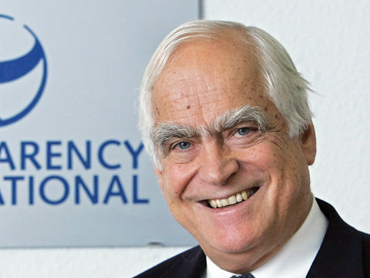
TRANSP
Peter Eigen
INTERNA
TI wasn’t making any progress (with extractive industries) So we wanted an additional approach that would tie in the companies from the beginning. In most countries fighting corruption is mainly the government and civil society. The big oil producing companies, it’s the government, the big oil companies and the people. And the government doesn’t dare do anything without asking the companies. You’re talking about billions and billions of dollars… in small countries, the poorest in the world. That’s different from TI’s work, such as getting a school teacher to give a student a good grade, without a bribe.”
Steve Waddell – Global Action Networks, 2011, p. 63

Slide 11
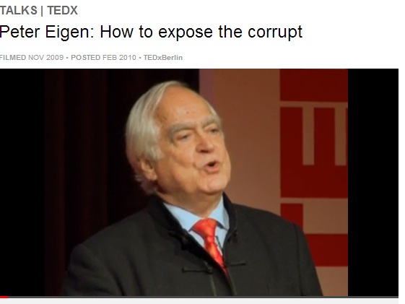
www.ted.com/talks/peter_eigen_how_to_expose_the_corrupt.html

Slide 12
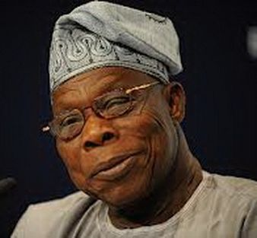
EITI Breakthrough
President Obasanyo of Nigeria in 2003 (at TI’s 10th anniversary):
  “I will not only allow companies operating in Nigeria to publish what they pay; I will make it mandatory for them. And I will publish what I receive.”

Slide 13
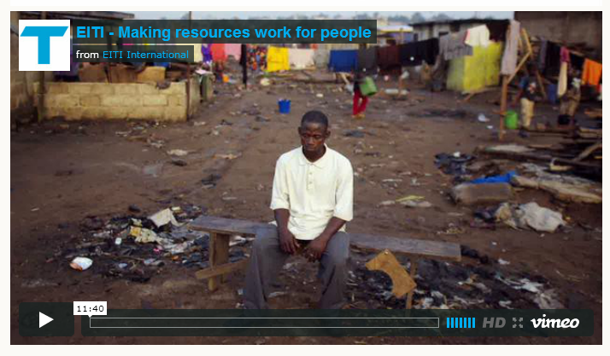
http://eiti.org/eiti/video

Slide 14
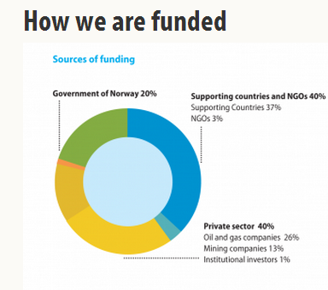
EITI:
http://eiti.org/about/funding

Slide 15
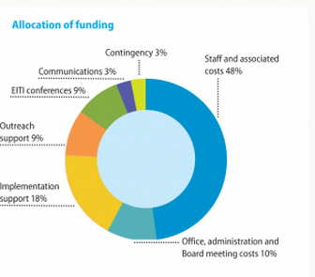
http://eiti.org/about/funding

Slide 16
Azerbaijan
EITI is a voluntary initiative that countries sign up to; companies do not sign up though they can be official supporters. As of August 2009, 30 mineral-rich countries including Nigeria are ‘candidate’ countries implementing EITI. This means they have met four sign-up indicators. Only one candidate country, Azerbaijan, has met the far more stringent validation procedures; it became EITI’s first (and currently only) ‘compliant’ country in February 2009.

Slide 17
Sign-up requirements
The government is required to issue an unequivocal public statement of its intention to implement the EITI.
The government is required to commit to work with civil society and companies on the implementation of the EITI.
The government is required to appoint a senior individual to lead on the implementation of the EITI.
The government is required to establish a multi-stakeholder group to oversee the implementation of the EITI.
The multi-stakeholder group, in consultation with key EITI stakeholders, should agree and publish a fully costed work plan, containing measurable targets, and a timetable for implementation and incorporating an assessment of capacity constraints.
http://eiti.org/files/2011-11-01_2011_EITI_RULES.pdf

Slide 18
NIGERIA
Nigeria has for some time been regarded as a flagship of EITI because of its relative success in publishing detailed data and for the relatively weighty institutional structure that has been allowed to build up inside the country.
For a while it enjoyed apparently strong political commitment; and the fact that it has been engaged for a long time: former President Obasanjo committed to EITI in November 2003 and launched Nigeria EITI, known as NEITI, in February 2004, right at the start of the global EITI process.
Nicholas Shaxson (2009) - Nigeria’s Extractive Industries Transparency Initiative
Just a Glorious Audit?, Chatham House, p.

Slide 19
NEITI evaluation
NEITI’s success consists of the audit reports of the 1999–2004 oil sector accounts themselves. These reports contributed to significantly better transparency in Nigeria’s oil industry, publishing an array of detailed information for the first time. Nothing remotely like this has been done before, let alone published.
EITI and NEITI did not drive reforms in Nigeria. Instead, they piggybacked upon major reforms that were happening anyway. NEITI was allowed to flourish, temporarily, amid the reformist political climate from 2003 to 2006.
Measured against broader goals of fostering better governance and accountability, the initiative has not shown impressive results.
NEITI’s attempts to build capacity in civil society have shown meagre results: although it has informed civil society it is hard to find evidence that it has significantly empowered or energized it.
The audience that has made most meaningful use of the NEITI reports are mostly located within elite circles and in government.
Shaxson 2009, Executive Summary

Slide 20
NEITI 2013 Audit: Time To Know Who Got What
The Nigeria Extractive Industries Transparency Initiative (NEITI) is set to commence a comprehensive independent audit of fiscal allocation and statutory disbursements of the extractive industries revenue funds from the federation account to the three tiers of government
The audit which has already been approved by the Federal Executive Council (FEC), presided over by President Goodluck Jonathan, on November 28, 2012, will cover January 2007 to December 31, 2011 .
It seeks to establish how funds from the extractive sector, which accounts largely for the country’s in-come, were distributed and received by the Federal, State and Local Government Areas (LGAs) within the period, given the alarming level of poverty in the country occasioned by the mismanagement of funds.
www.publishwhatyoupay.org/resources/neiti-2013-audit-time-know-who-got-what

Slide 21
DRC evaluation….
Since initiation and installment in 2008, only one meeting has been held in 2008, the official EITI forum in Kinshasa. Afterwards, no activities centered on awareness creation or promotion of good governance principles have been undertaken by the national committee to improve visibility or awareness. Any awareness creating initiatives that have been done are on the part of civil society organizations. EITI has little to no visibility amongst the targeted beneficiaries, namely the local population.
Questions are raised about the sincere wish to implement EITI on part of the government, due to the lagging of facilitating the process properly, overdue payment of salaries of EITI personnel, and the delay of signing a decree that enables the installment of a provincial office in Katanga. More than one respondent claims the government participates solely for the outside world to show its dedication to good governance processes.
www.multi-part.eu

Slide 22
Perceptions of EITI
1. Some see it as, if not a magic bullet to deal with the so-called ‘resource curse’, at least a powerful driver of beneficial reform.
2. Others see it as a potentially useful but limited entry point into a difficult area.
3. There are those who see EITI as a rather meaningless, distracting box-ticking exercise – in effect little more than a reputational tool for companies, governments and donor agencies.
Shaxson 2009, Preface

Slide 23
Challenges
“China and Arab countries present real challenges when trying to organize a multi-stakeholder platform since the governments are so dominant. This is one reason why EITI put Tunisia on the back burner for membership. The global imbalance between wealthy and poor countries also creates problematic dynamics. The countries implementing EITI’s standards are from the latter, and financial supporters are from the former. ... “
Steve Waddell – Global Action Networks, 2011, p. 219

Slide 24
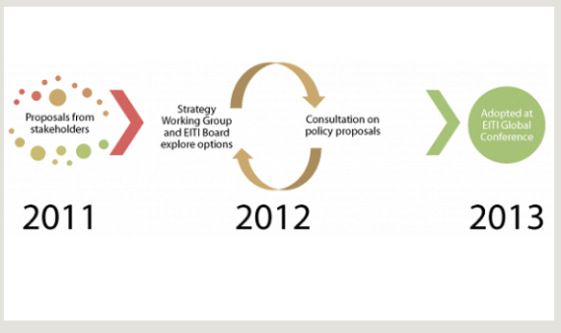
EITI overhaul

Slide 25
Better EITI standards
Making the EITI Reports more understandable.
Making EITI more relevant in each country.
  better grounded in a national dialogue about natural resource governance
Better and more accurate disclosure
  broken down by company and revenue stream
Recognising countries that go beyond the minimum
A clearer set of rules, with room for adaptation

Slide 26

LET US REFORM THE EITI

Slide 27

http://www.revenuewatch.org
The Revenue Watch Institute is a non-profit policy institute and grantmaking organization that promotes the effective, transparent and accountable management of oil, gas and mineral resources for the public good.
Revenue Watch began in 2002 as a program of the Open Society Institute and focused on Azerbaijan, Kazakhstan and Iraq, especially on how authorities collected and used the money earned from oil.
RWI became an independent organization in 2006, as our founding donors—the Open Society Foundations, the William and Flora Hewlett Foundation and the Norwegian Oil for Development Fund—saw rapidly rising demand and need for our work.
A mainstay of RWI's work is the development of civil society capacity. RWI provides financial and technical training and support to more than 50 partner organizations on every aspect of oil, gas and mining.
RWI is also a leader in the development and implementation of the Extractive Industries Transparency Initiative (EITI) and has been since EITI's inception.

Slide 28
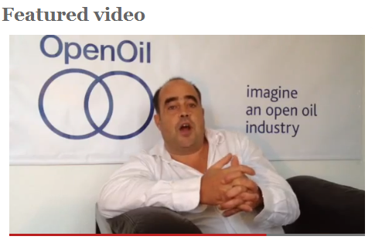
5. http://openoil.net/

Slide 29

6.
Established in 2000, the Voluntary Principles on Security and Human Rights—an initiative by governments, NGOs, and companies—provides guidance to extractives companies on maintaining the safety and security of their operations within an operating framework that ensures respect for human rights and fundamental freedoms.
The Voluntary Principles (VPs) are the only human rights guidelines designed specifically for oil, gas, and mining companies.
http://www.voluntaryprinciples.org/files/VPs_Fact_Sheet_October_2012.pdf

Slide 30
Common interests
Governments of the United States, the United Kingdom, the Netherlands and Norway, companies in the extractive and energy sectors (“Companies”), and non-governmental organizations (“NGOs”), all with an interest in human rights and corporate social responsibility, have engaged in a dialogue on security and human rights.
The participants recognize the importance of the promotion and protection of human rights throughout the world and the constructive role business and civil society — including non-governmental organizations, labor/trade unions, and local communities — can play in advancing these goals. Through this dialogue, the participants have developed a set of voluntary principles to guide Companies in maintaining the safety and security of their operations within an operating framework that ensures respect for human rights and fundamental freedoms.

Slide 31
Slow progress
The UK Government hosted the 2010 Annual Plenary, held in London on 18-19 March. Key outcomes included the announcements of Colombia and Switzerland becoming newly engaged governments, Canada moving from engaged to participating government status, and Search for Common Ground joining the NGO pillar. In addition, a commitment was made by participants to learn from, and build on, the progress that has been made in recent in-country work in Indonesia, Peru and Colombia, as well as the mediation process presented by Oxfam and Newmont. The Implementation Guidance Tool (IGT) project was announced and an IGT Working Group was established. The aim of the project is to produce a practical tool by the Plenary in 2011. While it was acknowledged that the standard of reporting has increased, the focus would be on sharing best practice and further improving the reporting process.

Slide 32
7. Amnesty International
Amnesty International is a global movement of more than 3 million supporters, members and activists in over 150 countries and territories who campaign to end grave abuses of human rights.
After more than 50 years of groundbreaking achievements, Amnesty International is now embarking on a major process of evolution, to adapt to the dramatic changes in the world we operate in, and to increase the impact of our human rights work.
http://www.amnesty.org/en/who-we-are

Slide 33
Campaign for the victims of oil spills
21 December 2012
A momentous ECOWAS court judgment will impact Nigerian communities like Bodo which are badly affected by oil spills.
Last week something momentous happened:
The event was a judgment in which ECOWAS (Economic Community of West African States) court ordered the Nigerian government to punish oil companies over pollution.
But while there was a pause for celebration the fight goes on because pressure is needed to make sure that the government adheres to this judgment.
Oil companies, particularly Shell, have managed to evade responsibility for far too long. And the Nigerian government has allowed them to do so, putting profits before people.

Slide 34

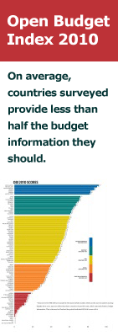
8. http://internationalbudget.org/
IBP works in five major areas:
Building budget analysis and advocacy skills through training and technical assistance
Measuring and advancing transparency, accountability, and public participation in the budget process
Contributing to strong and sustainable organizations by providing financial assistance for civil society budget work
Enhancing knowledge exchange among civil society budget groups and other public finance stakeholders by acting as a hub of information on civil society budget work
Building vibrant international and regional budget networks

Slide 35
9. Stakeholder Democracy Network www.stakeholderdemocracy.org
SDN works to empower those that have been worst affected by the activities of extractive industries, to help them to get a better deal.
SDN is piloting its approach in the Niger Delta working with local communities and civil society groups. The Niger Delta is one of the world worst example of resource curse. The paradox of the Delta is acute poverty in the midst of plenty.
SDN works in the Niger Delta on
Forced evictions and demolitions; Oil spills; Gas flares; Human rights; Community development and empowerment; Strengthening Transparency and Accountability;

Slide 36

10. ELLA Learning Alliance on Extractive Industries
Learning Alliance on Extractive Industries
ACHIEVING RESPONSIBLE EXTRACTIVE INDUSTRY INVESTMENTS
This Learning Alliance has been underway since April 2012 and is closed to new members.
Selected highlights from the discussions and knowledge exchange that took place will soon be available to download from the ELLA Knowledge section of the website.
http://ella.practicalaction.org/learning-alliances-1

Slide 37
International NGO activity
Global Witness
Publish what you pay
Extractive Industries Transparency Initiative
Revenue watch
Open Oil
Voluntary principles
Amnesty International
International Budget Partnership
Stakeholder Democracy Network
Natural Resource Charter

Slide 38
Assignment for this afternoon
1. Check the websites of the 10 organisations and google the organizations + your country of choice to see which organizations have been active in the country and what they have done or published.
2. Compare these activities with the possible activities identified the day before. What are the “white spots” on the policy map?
3. Devise an Action Plan to fill the void (at least 10 priority points) for presentation tomorrow.

