Slide 1

ESF inleiding
BEYOND THE RESOURCE CURSE
ESF-workshop
Paris, 2-4 November 2011
2 November 2011

Slide 2
Opening
Introduction:
  Personal history
  TNU & MODOP
Points of departure
The programme
The objectives
  A research programme
  An online course as a research instrument

Slide 3
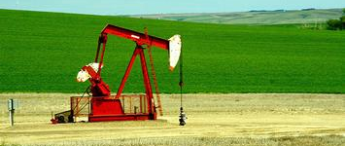
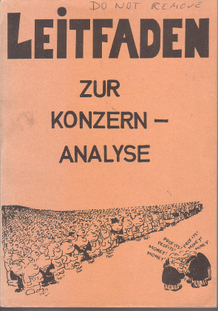
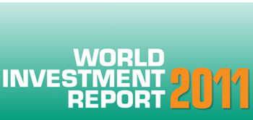

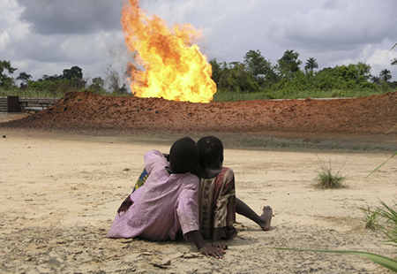

Personal resource curse history
Erdöl für Europa
1974
Alternative Annual Reports
1978
UN Centre on Transnational Corporations
1989-2002
1977-1981
2008-2010
Postconflict Development
2000-

Slide 4


Modus Operandi is an independent institute founded by its current directors in 2006. The institute carries out research, teaching and organises debates on conflict transformation and political transition. Its work focuses on three themes within the context of post-conflict and post-Soviet countries. These themes are: state dynamics, political legitimacy, and business and conflict.
The Network University offers opportunities for learning, capacity building and provides innovative services for social transformation by developing courses on issues of social relevance in the global context and assisting in conceptual and content development, action research, and policy development with the ultimate aim to contribute to social change.

Slide 5
New actors and contracts
New buyers/investors: China, India, South Korea...
New producing countries: Uganda, Ghana, Cambodia, Malawi ...
New companies: Lundin Petroleum, Tullow Oil (UK)
New (inter)national networks: EITI, IANRA, .....
New contracts and legislation: Dodd Frank Act ....

Slide 6
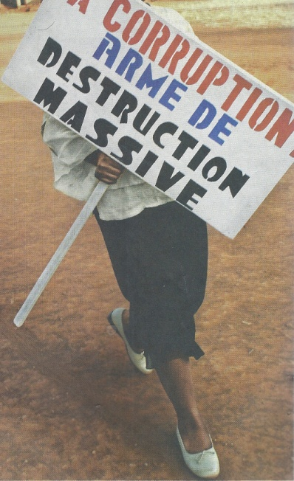
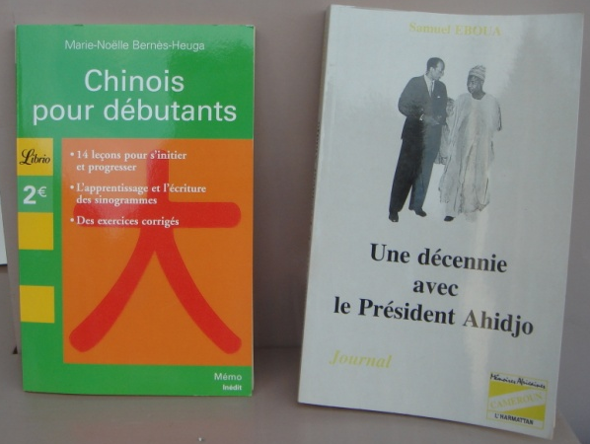
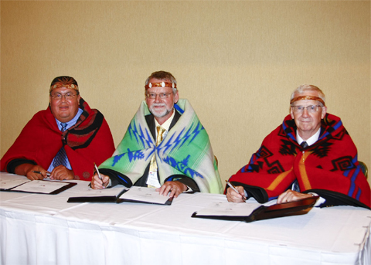
The programme
New players, changing international relations, new conflicts | Rentier economies and neo-patrimonialism | Changing state-society relations through tripartite governance over natural resources

Slide 7
Objectives of the workshop
Research plan
  Perhaps a common grant application (or several) by subgroups
  Inspiration for thesis writers to find a relevant topic (which contributes to a larger endeavor)
An online e-learning programme
  As a research tool
  As a knowledge management channel
  As a knowledge sharing & dissemination device

Slide 8


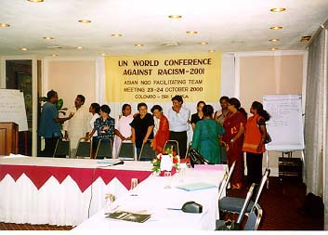
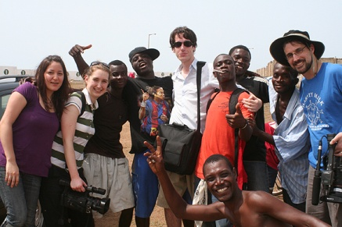
For whom is the online programme?
For civil servants
For company staff interested in CSR
For new staff in NGOs
For students worldwide

Slide 9
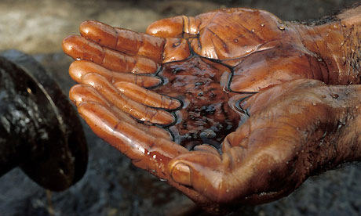
Beyond the Resource Curse
Week 1 | Week 2 | Week 3 | Week 4
New and old actors: the new “great game” New producing countries: the scramble for Africa World climate discussion World conjuncture | Mechanisms of the Resource Curse, links with conflict Country examples Resource examples Academic discussion Different types of natural resources Different societal constellations | Mechanisms to counter the resource curse within producing countries governance frameworks changing power relations | International mechanisms to address the resource curse National legislation in consuming countries International sanctions - Multi-Stakeholder Networks

Slide 10

Who will finance the programme?
On the basis of a comprehensive description of the planned programme, a broad range of institutions and companies will be asked to prepay for the participants from that organisations, with the guarantee for full re-imbursement if the programme is not offered before a given date. These pre-payments should cover the first version of the programme, which afterwards will have to finance itself from course fees.
Participants can earn part of the fees back by substantial contributions to the further elaboration of the programme.

Slide 11
New actors: Chinese barter contracts: raw materials for infrastructure
Angola (2004): $ 2 billion
Gabon (2006): $ 3 billion
DRC (2007): $ 8 billion
Guinea (since 2009): $ 7 billion
Zimbabwe (since 2009) $ 8 billion
            Global Witness, China and Congo: Friends in Need, 2011, 11-12

Slide 12
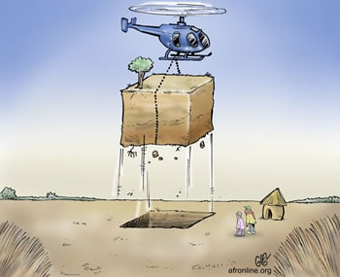
Large scale land grabbing
Example: South Sudan
At the top of African list for number of contracts
Use of lack of regulation in transition period
Some contracts cover 2 million ha.
Purpose is often speculation, therefore little investment

