Slide 1
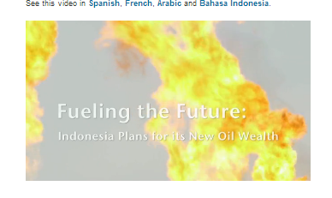
Day 3
WHAT CAN BE DONE ?
16 January 2013

Slide 2
Agenda Day 3: What can be done?
Recap of Day 2
Assignments
Changing properties of oil revenues
Example: Chad project

Slide 3

What kind of measures would YOU take?
Y

Slide 4

The other side of
THE CURSE

Slide 5
Teodorín Obiang
Son of Equatorial Guinea’s dictator Teodoro Obiang who came to power in 1979 by a military coup
Minister of Agriculture, earning $ 6,799 a month
Commissioned plans to build a superyacht costing $ 380 million, nearly three times what the country spends on health and education each year
Stated that public officials in his country are allowed to partner with foreign companies bidding for government contracts and said this means “a Cabinet member ends up with a sizable part of the contract price in his bank account”

Slide 6


Should people like Teodorín Obiang
. .. be denied access to your country?
... receive a warm welcome as wealthy customers, or.....

Slide 7
Changing properties of oil revenues
Limit the size
Alter the source
Make them more stable
Make them transparent
(Cf. M.L.Ross 2012, 234)

Slide 8
1. Limit the size
Leave the oil in the ground (for later)
Barter contracts
Direct distribution to citizens
Transfer to regional & local government

Slide 9
a) Leave oil in the ground?
“Irony of oil wealth”:
... The greater a country’s need for aditional income – because it is poor and has a weak economy – the more likely its oil wealth will be misused and squandered. (M.L.Ross 2012, 236)

Slide 10

b) Barter contracts
+
May reduce transaction costs
Good for low-capacity governments
-
Tied to one supplier
Process of “bundling”
Little transparency
Unimpresive historical record

Slide 11
c) Distribution to citizens
Might give citizens an incentive to monitor government, but
Would probably lead only to more consumption and little saving
Much might get lost in the process of distribution

Slide 12
d) Transfer to local government
Local governments should be entitled to funds that compensate for social and environmental costs , but
Might just “multiply” the curse
Local government often less capable
Same antidemocratic effects as at national level

Slide 13
d) Transfer to Local government (2)
“Policy makers can devise revenue systems that tamp down fluctuations in the volatility of subnational revenues;
insist that local governments use any oil revenues to complement, not substitute for, their existing tax base;
make sure that new revenues are paired with expenditure responsabilities linked to the provision of public goods;
and stipulate that all shared revenue must be fully transparent and regularly audited.” (M.L.Ross 2012, 240)

Slide 14

How would you divide export incomes between central authorities and the producing region?

Slide 15
Capacity building
Subnational governments are receiving increasing resource revenues, are regulating and managing many different aspects of the extractive sector, including land allocation questions, pollution, changes in the local economy, demands for services and guarantees of security and human rights, and are responsible for providing money for the most important social services to their citizens. Building capacity of subnational actors is key to improving governance of extractive industries.
Revenue Watch Institute’s capacity building program works with local and national governments, civil society, journalists and companies to promote transparent, accountable and effective management of nonrenewable natural resources.
http://www.revenuewatch.org/issues/subnational

Slide 16
RWI: Six draft papers
Subnational Revenue Management
La Distribución de la Renta de las Industrias Extractivas a los Gobiernos Subnacionales en América Latina
Local Content in the Oil, Gas and Mining Sectors: Enhancing the Benefits at the Subnational Level
Corporate Direct Social Expenditures: A Local Monitoring Guide for Civil Society Organizations
The Subnational Resource Curse: Causes, Consequences and Prescriptions
Local Level Resource Curse: The “Cholo Disease” in Peru
http://www.revenuewatch.org/news/blog/subnational-draft-papers

Slide 17
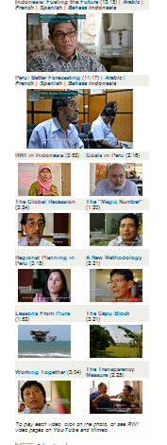
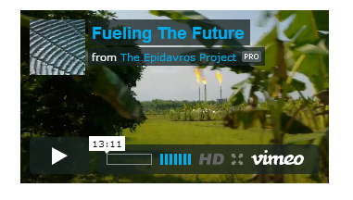
RWI video’s
http://www.revenuewatch.org/issues/subnational/videos

Slide 18
2. Change the source
“If state ownership is part of the disease, then privatization might seem like part of the cure.” It would replace nontax revenues with tax revenues from private-sector companies.
A study of the five petroleum-rich states of the former Soviet Union finds that oil wealth only leads to weakened state institutions when government has a dominant role in the oil industry.
“But some medicines are worse than the diseases that they are prescribed for.” (M.L.Ross 2012, 228)

Slide 19
Privatisation?
Size and financial sophistication of international oil companies makes them exceptionally tough for governments, especially in low-income countries, to tax and regulate” (M.L.Ross 2012, 240)
Privatisation in the oil sector might simply replace nontax revenues with levies, and therefore provide citizens with little direct information about the size of the government’s revenues. (M.L.Ross 2012, 241)

Slide 20
3. Stabilizing Petroleum Revenues
Stabilization Funds – “economically intelligent but politically inept” (M.L.Ross 2012, 242)
Politicians typically find ways to siphon off the surplus, either by changing the rules, replacing the people who oversee the fund, or simply borrowing money against the savings.
A better design would place the politically beneficial part first and make the politically painful part mandatory. (M.:.Ross 2012, 243)

Slide 21
Foreign Loans (to stabilize revenues)
Oil-denominated loans
Angola has been using oil denomated loans for decades. (M.L.Ross 2012, 244)
Insurance against falling oil prices (example of Mexico)

Slide 22
Restrict volatility
“Much can be done to give democratic leaders longer time horizons and encourage greater restraint.”
“When a resource-rich government is subject to more checks and balances, it is less likely to overspend any surpluses”. (M.L.Ross 2012, 217)

Slide 23
4. Less secrecy
Transparency is cheap to implement and unlikely to do harm.
Information must be made widely available at little or no costs, and it should be presented in a format that ordinary people can understand.
Transparency cannot magically solve the problems of resource-rich countries, but it is probably the safest and simplest way to bring about improvements (M.L.Ross 2012, 247)

Slide 24
Transparency
“Oil income is only linked to less democracy when it is paired with exceptional government secrecy” (M.L.Ross 2012, 108)
“A 2010 study found that 74 of the 94 governments surveyed had national budgets that failed to meet basic standards of transparency and accountability. Oil- and gas-producing countries were among the most opaque. Algeria, Cameroon, Chad, Equatorial Guinea, Iraq, and Saudi Arabia published virtually no information about their budgets” M.L.Ross 2012, 249 - cf. www.internationalbudget.org

Slide 25
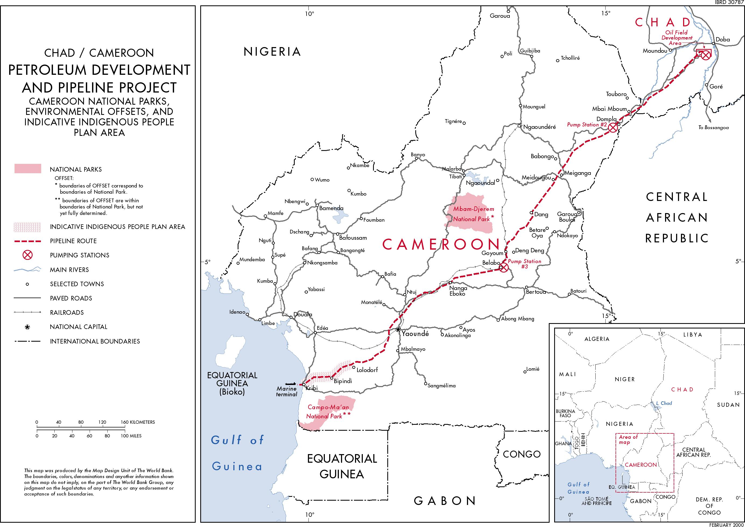
Notes:
25

Slide 26
CHAD – an introduction
One of the five poorest countries in the world
One of the most corrupt countries
142nd of the 145 countries in 2003 (TI, 2003)
Civil war between 1965-1982, and continuous conflicts between government and rebel movements
Oil found in in the 1970s, definite contract in 1999

Slide 27
Exploitation of three oil fields in the South
Pipleline of 1040 km via Cameroon
Consortium members
  ExxonMobil, Chevron and Petronas
  Governments of Chad and Cameroon,
  World Bank

Slide 28
WORLD BANK PLAN
Revenue Management Plan (Law)
  Framework for division of oil income
  Committee of Government and NGOs to control expenditures
Environmental Management Plan
  Avoid environmental, socio-economic and health problems
  Government committee to oversee implementation
Capacity Building for government
Monitoring by external institutions

Slide 29
REVENUE MANAGEMENT PLAN
Gross Oil Revenue to Chad (all oilfields)
WB Debt Service
Direct and Indirect Revenues
(Royalties, Dividends, Taxes)
Escrow Account
(Citibank)
Public Treasury of Chad
Chadian Commercial Bank Account
25%
5%
70%
Oil Producing
Region
Stabilisation Account
: Monitored
Priority Sectors
: Unmonitored

Slide 30
Revenue Management Plan (2)
Expected impact:
  Reduction of corruption
  Concentration of investment on health and education (instead of military security)
  Reduction of regional disparities
Problems
  Capacity of oversight committee
  Vague definition of priority sectors
  Neglect of local government in production areas

Slide 31
ENVIRONMENTAL MANAGEMENT PLAN
Expected impact: avoid grievances resulting from pollution and lack of compensation for land
Problems:
  Monitoring capacity of government
  Did not take dust forming into account
  Non-implementation of migration plan

Slide 32
Overall impact
Less democracy
  More expenditures on internal security
  But also better education
Higher economic growth
  More corruption
  Government less dependent on taxes – spends more on own ethnic group
More conflicts, but not (yet) in oil region
  In spite of increased grievances

Slide 33
LESSONS
Government capacity building too late
  Remaining dependence on external monitoring
Framework for distribution oil income too complicated and not clear enough
Environmental Management Plan not really comprehensive
World Bank gets criticism, companies make profits.

Slide 34
INSPIRATION
Schemes desirable that combine international, national and regional/local actors
Involvement of NGOs in monitoring and decision making on release of funds
Strong back-up of NGOs by international institutions
Levrage of international institutions for introduction of such schemes

Slide 35
Possibilities in the near future
Willingness of international institutions to back such schemes?
Alternative Chinese investment
Willingness of government to commit itself?
Strength of local institutions?
Contribition of NGOs to create local preconditions for such schemes to work?

Slide 36
Different contracts
“Governments have little control over oil prices, but they have a lot of control over contracts. Yet instead of designing contracts that stabilize their revenues, most governments now sign contracts that seem to further destabilize their revenues.” (M.L.Ross 2012, 58)

Slide 37
Patriarchy
Oil wealth does not necessarily harm the status of women. It depends on whether women have opportunities to work in the service sector which typically grows in tandem with oil revenues.
Seven oil countries still made fast progress on gender equality: Norway, New Zealand, Australia, Uzbekistan, Turkmenistan, Syria, and Mexico. (M.L.Ross 2012, 131)

Slide 38
Diversification
Not all oil states suffered during the 1974-89 slump. Per capita income rose 89 % in Oman and 78 % in Malaysia
Important factor: government leadership
Malaysia in particular built a well-diversified economy and strong manufacturing sector, thanks to both skillful industrial policies and an oil endowment that was too small to cause serious problems from the Dutch Disease.
(M.L.Ross 2012, 194)

Slide 39
Diversification
Mongolia’s President Tsakhia Elbegdorj, answering the question “Are you confident that your country’s natural wealth can lead to real development?”
“As president, I must educate and invest in our people. We have to invest in health, education and socioeconomic infrastructure. And invest in other sectors, like agriculture”
TIME, October 22, 2012, p. 56

