Slide 1
Remittances
How to increase them and making them less expensive?
Gerd Junne
Addis, 26 November 2014
gjunne@gmail.com

Slide 2
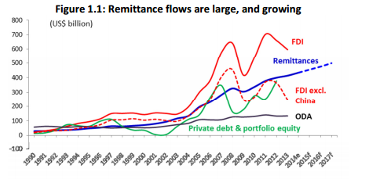
Increase of worldwide remittances
World Bank, Migration and Development Brief 23, 6 October 2014

Slide 3
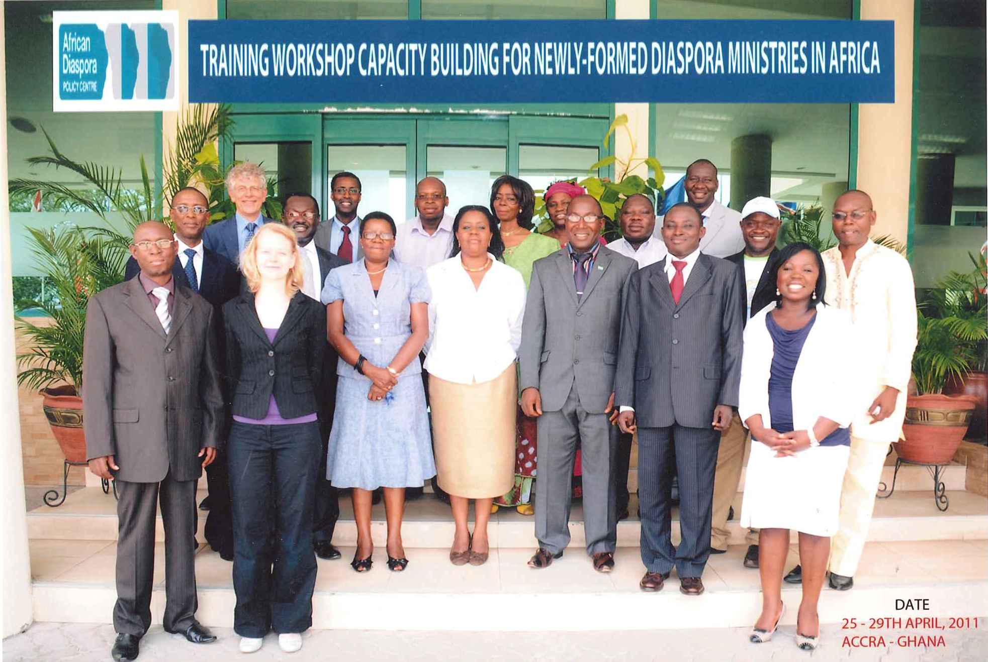
If this increase had not happened, we would not be here today

Slide 4
Remittances to Africa
 | Remittances in billion US-$
 | 2012 | 2013 | 2014 | 2015 | 2016 | 2017
World | 531 | 551 | 582 | 608 | 636 | 667
Sub-S Africa | 31 | 32 | 33 | 34 | 36 | 38
% | 5.8 | 5.8 | 5.7 | 5.6 | 5.7 | 5.7
World Bank, Migration and Development Brief 23, 6 October 2014

Slide 5
Remittances larger than development aid
remit more money than development aid
30 million Africans outside of Africa
http://www.remittancesgateway.org/index.php?option=com_content&view=article&id=2028:african-diaspora-remittances-better-than-foreign-aid&catid=15:businessweek&Itemid=109

Slide 6
A blessing …. and some challenges
Remittances could be higher
Remittances could be cheaper
More remittances could be sent through formal channels
Remittances could be better used for development purposes
4 x 4 Strategy

Slide 7
Increase remittances: Four strategies
Make it easier to remit
Lobby for good payment to migrant workers
Improve the investment climate
Engage with 2nd and 3rd generation migrants

Slide 8
1. Make it easier to remit
Increase the number of channels.
Reduce the costs of remittances.
Increase the number of banks with affiliates in home and host country:
“ … Bank has rolled out the Diaspora Club banking service designed for you, working or studying abroad! We recognize that, you are special with unique financial needs that include banking in multiple currencies”

Slide 9
2. Lobby for good payment to migrant workers
Negotiate higher payments for migrant workers (and less deductions).
Improve pre-departure training.
Make opening of a bank account obligatory before departure.
Reduce costs for recruitment agencies, medical checks, and travel costs.

Slide 10
3. Improve the investment climate
Make it easier to invest in housing and land.
Make it easier to open a company.
Create a favourable taxation for Small and Medium-size enterprises (SMEs).
Provide information on investment opportunities.
Develop “business in a box” models.
Showcase role models.

Slide 11
4. Engage with 2nd and 3rd generation
2nd and 3rd generation migrants tend to remit less
Increase involvement of young generation through holidays, internships, school placement, online courses, festivals

Slide 12
Costs of remittances : a “super tax”
Africans face the highest remittance fees globally
Reducing remittance charges to global average would generate $1.8 billion, enough to put 14 million children through primary school, or provide clean water to 21 million people
The average cost to transfer $200 to sub-Saharan Africa was about 12 percent, compared with a global average of 7.8 percent
      ODI - "Lost in intermediation”, London 2014

Slide 13

G20: 5 x 5 plan
5%
Cost reduction for remittances
5 years

Slide 14
Reduce the costs of remittances: four strategies
More competition between Remittances Services Providers (RSPs)
Control of exchange rates of RSPs
New technologies
Youth as enablers

Slide 15
1. More competition
Do away with monopolies.
Abolish exclusivity arrangements that many Money Transfer Organisations (such as Western Union and Moneygram) have with their agents. That limits competition.
Broaden the range of institutions that can serve as agents, especially in peripheral rural areas – include e.g. post offices and microfinance organisations.

Slide 16
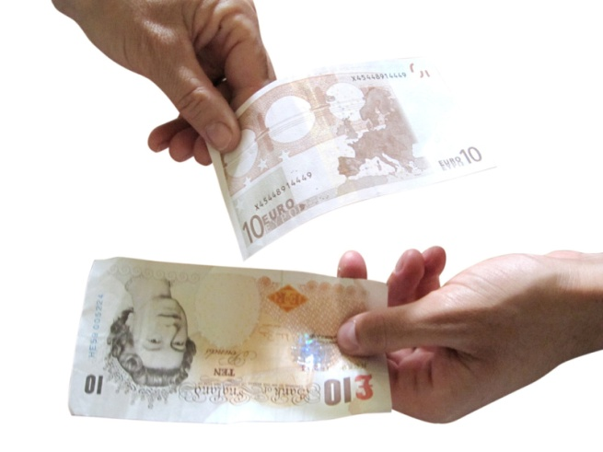
2. Control of exchange rates of RSPs
Since fees of RSPs are internationally under pressure
… some RSPs have lowered commissions, but compensate that by applying exchange rates which provide them with the same margins as before in a way which is
… much less transparent.

Slide 17
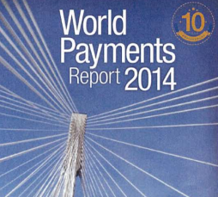
3. New technologies
One of the conclusions from:
“The fast development of technologies including smartphones, cloud-based solutions and real-time payments was not anticipated.”

Slide 18
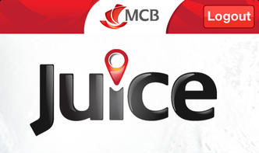




Fast expansion of “mobile money”
Mauritius
 |  | Zambia: Mobile money accounts surpass bank accounts

Slide 19
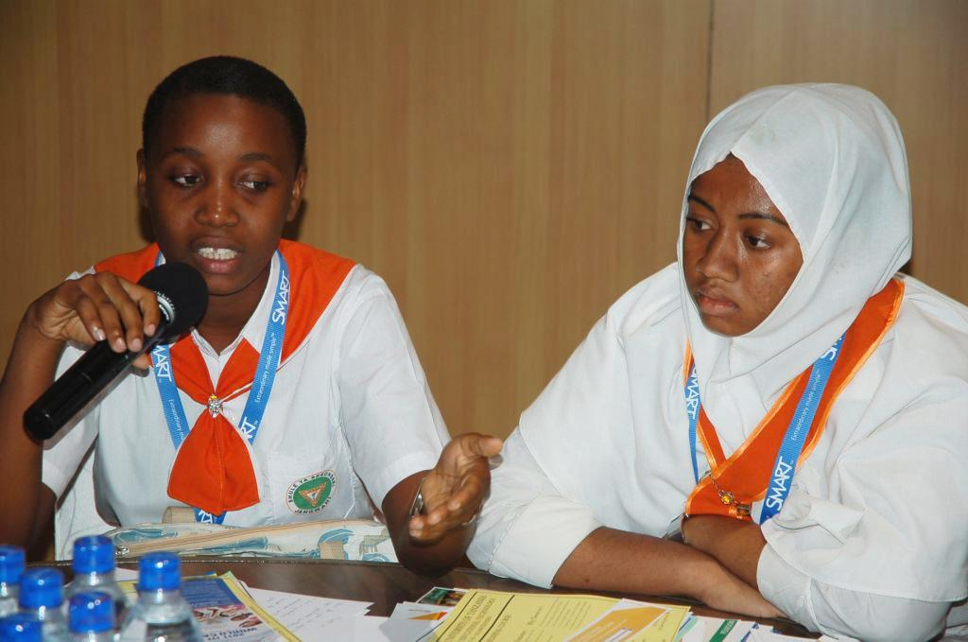
4. Youth as enablers:
Reach out to second and third generation migrants – to teach their parents how to use new remittances technologies.
http://www.elearning-africa.com/eLA_Newsportal/wp-content/uploads/eLA11-Youth1.jpg
This would help to reach TWO objectives:
It would facilitate the adoption of cheaper remittances channels by the parents
It would help to mobilize second and third generation diaspora youth.

Slide 20
More remittances into formal channels: four strategies
Give up managed exchange rates to avoid a black market
Limit overregulation of remittance services providers
Make sure that every citizen can open a bank account
Expand the use and ease of mobile payments

Slide 21
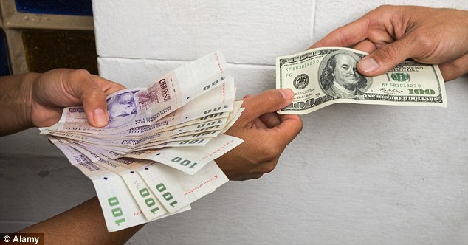
1. Give up managed exchange rates to avoid a black market
As long as the exchange rate on the black market is more advantageous than the official exchange rate, it remains difficult to get remittances into official channels

Slide 22

2. Limit overregulation of remittance services providers

Slide 23
3. Make sure that every citizen can open a bank account
Excellent example:
The Central Bank of Bangladesh ordered banks to open bank accounts for 19 million farmers.
Make opening of a bank account a step of any pre-departure programme.

Slide 24

4. Expand the use and ease of inernational mobile payments

Slide 25
Better use of remittances for development: four strategies
Formal channels create leverage of the domestic financial system
Collective remittances help to improve infrastructure
Philantropist investment reduces inequalities
Investment in entrepreneurship reduce dependency on remittances

Slide 26
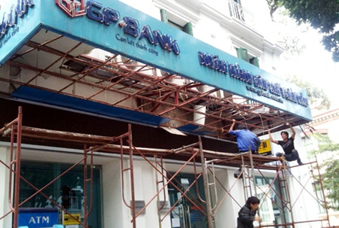
1. Formal channels create leverage of the domestic financial system

Slide 27
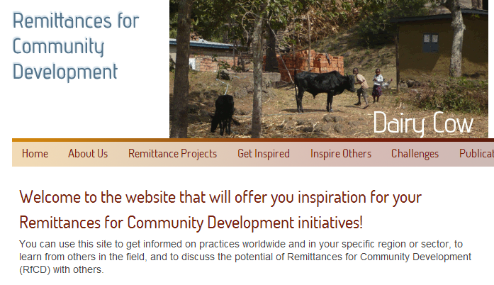
2. Collective remittances help to improve infrastructure
www.rfcd.net

Slide 28

3. Philantropist investment reduces inequalities

Slide 29
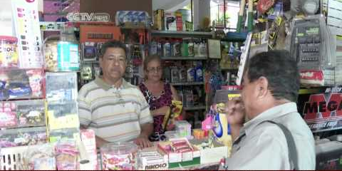
4. Investment in entrepreneurship reduce dependency on remittances

Slide 30

African Remittances Institute
This project is led by the African Union with the support of the World Bank and the European Commission, and in cooperation with ADB and IOM.
THANK YOU !

