Slide 1

Social Entrepreneurship in The Netherlands
Prof. dr. Gerd Junne
The Network University (TNU)
16 November 2016

Slide 2
The Netherlands

Slide 3
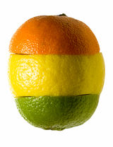
A day in a social enterprise world
What makes an enterprise “social”?
The five award winners “For the World of Tomorrow”

Slide 4
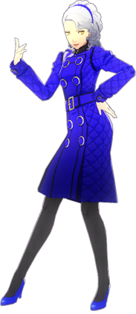
I. Let me introduce you to Saskia
Saskia invites us to accompany her through a social entrepreneurship day in Amsterdam

Slide 5
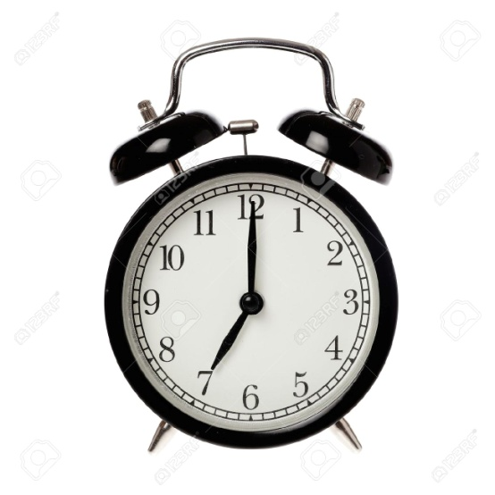
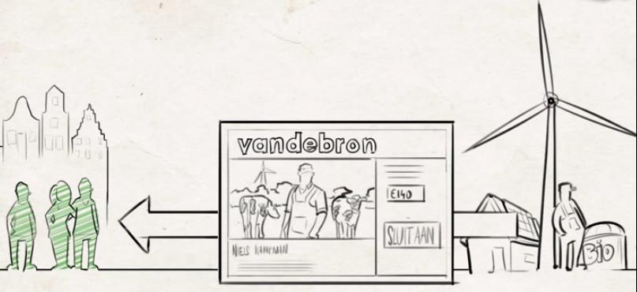
Good morning!
Wintertime – light on:

Slide 6
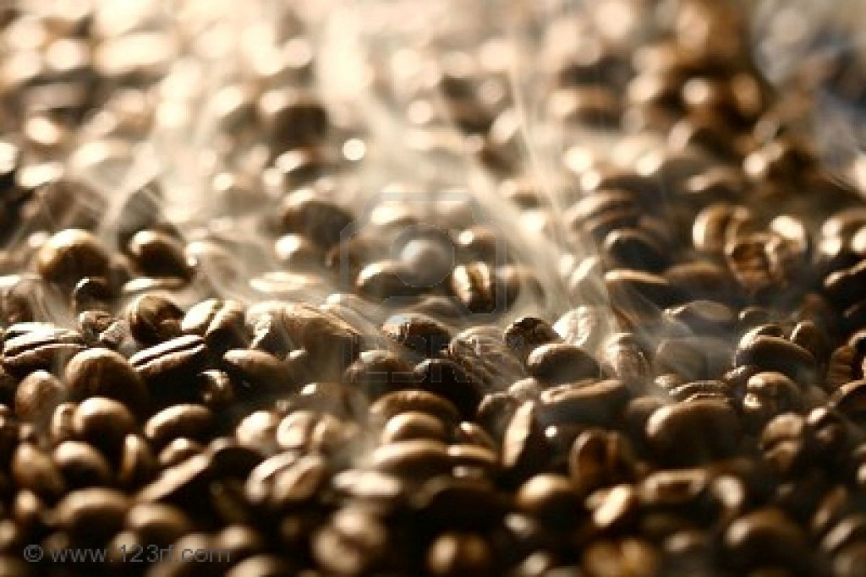

The smell of coffee

Slide 7

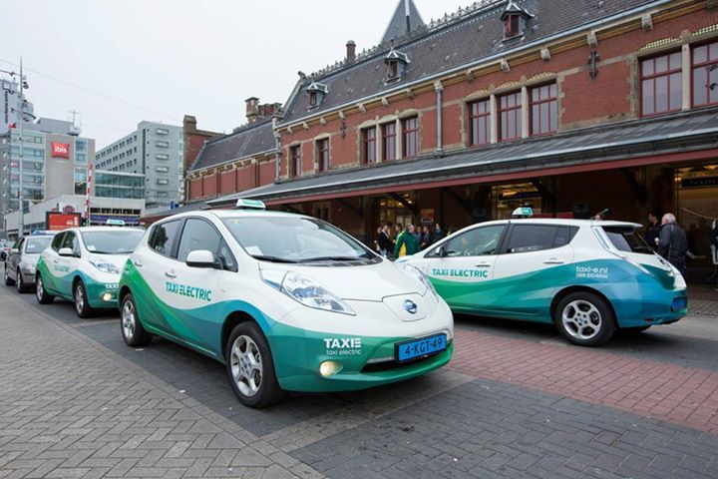
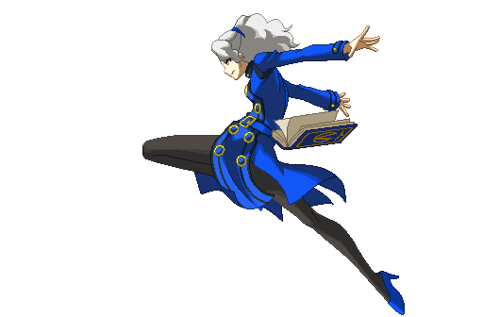
Taxi Electric

Slide 8

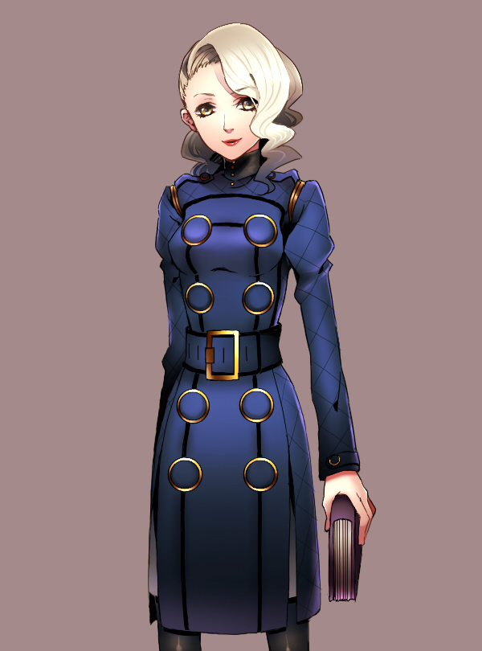
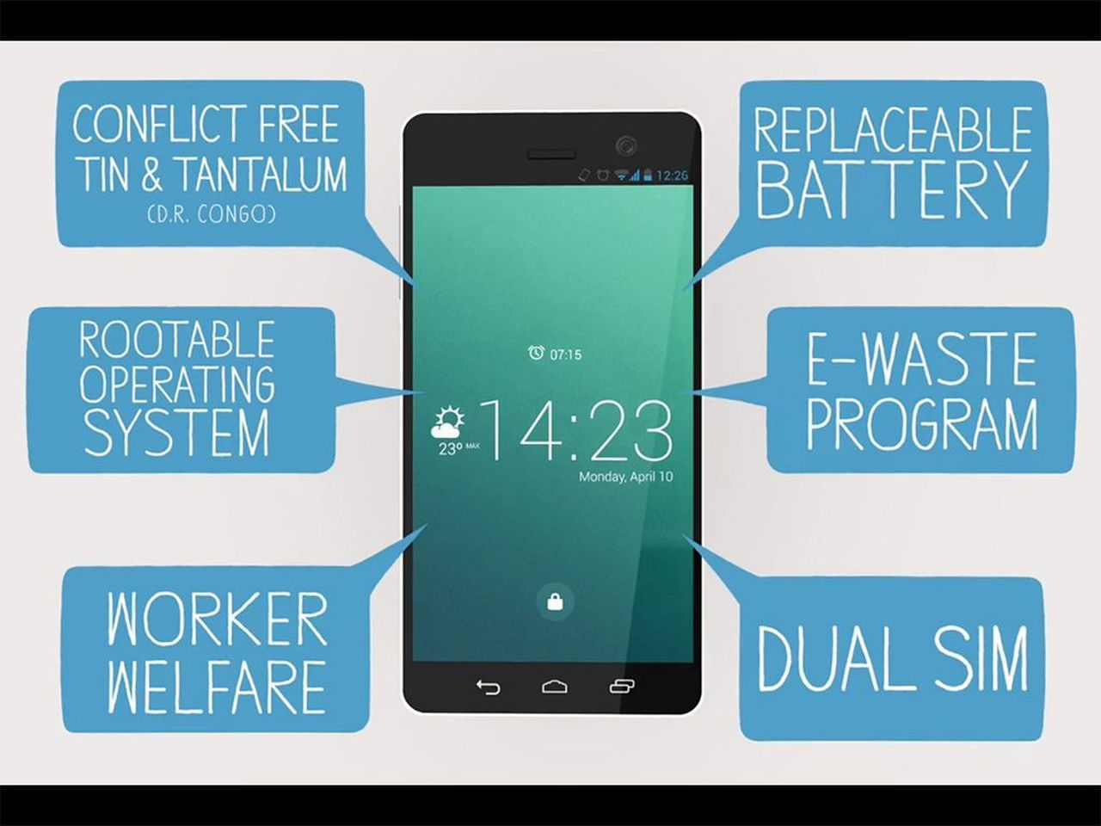
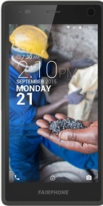
Fair Phone

Slide 9


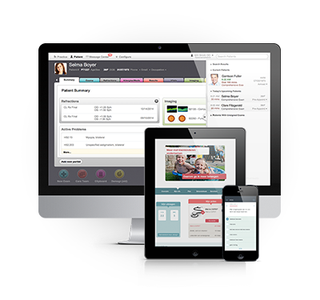
A company founded in 2006 by the Mayo Clinic (USA) and the Noaber Foundation (NL) to offer cloud-based solutions for chronic diseases like diabetes, depression, heart diseases, and Alzheimer.

Slide 10


Social Bite
Freshly prepared food made with local produce
1 in 4 of our staff are formerly homeless
100 % of our profits go to charity
We also feeds the local homeless
We trains homeless people in the “Social Bite Academy”

Slide 11
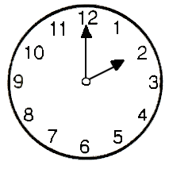
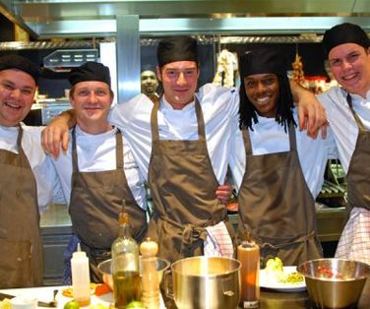
Lunch at the Colour Kitchen

Slide 12
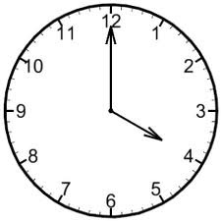
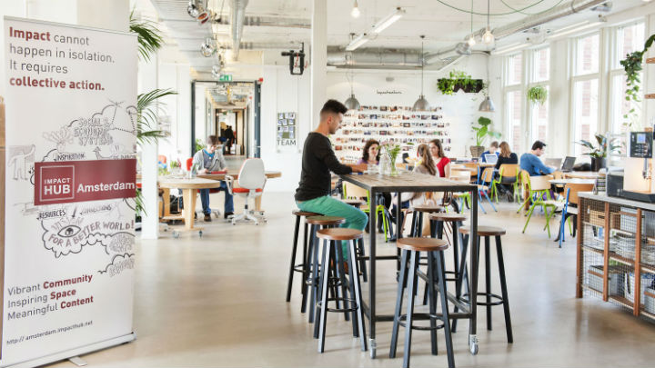
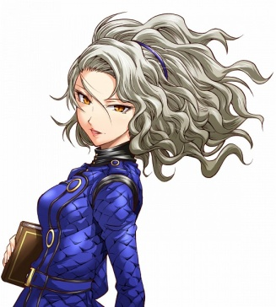
Appointment at Impact Hub

Slide 13

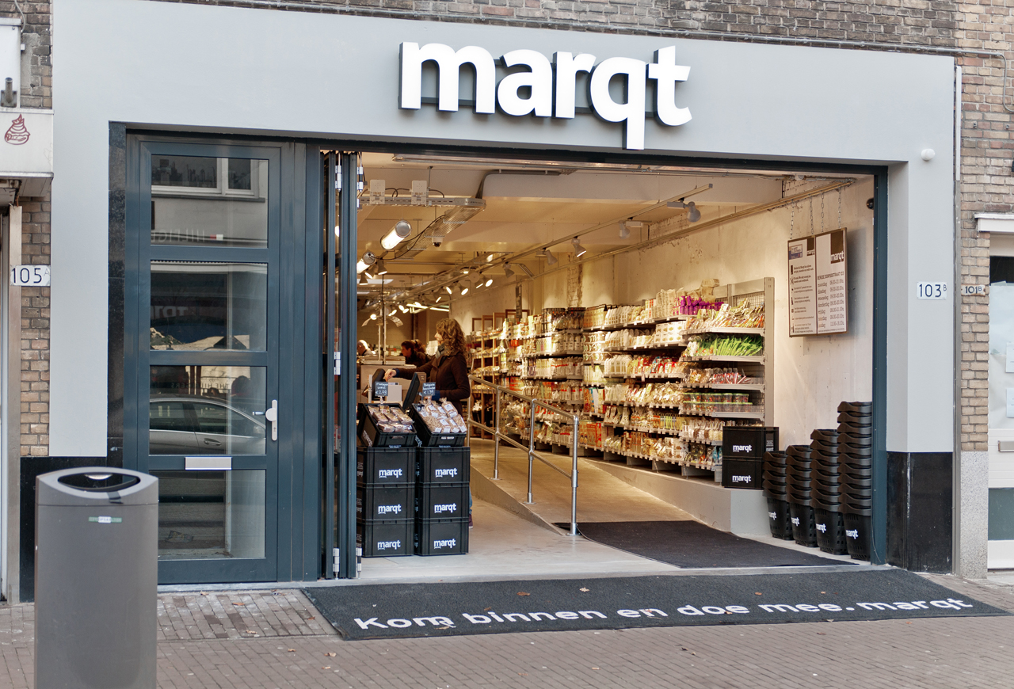
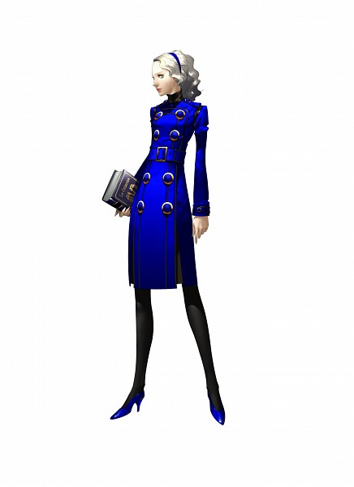
Marqt

Slide 14
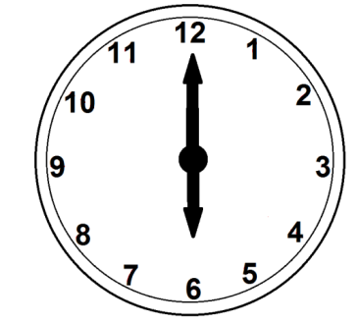

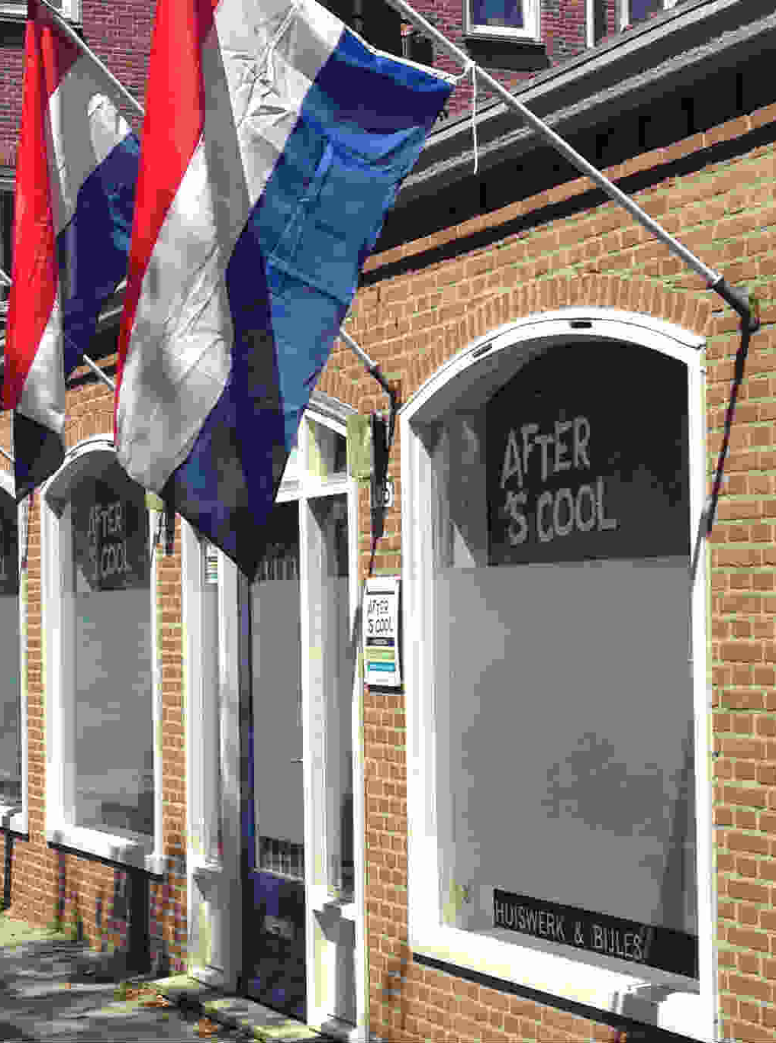
After S’COOL

Slide 15

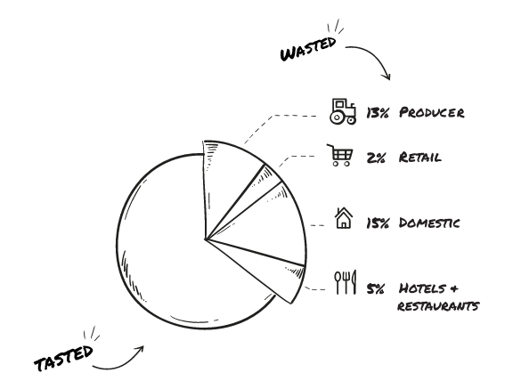
InStock

Slide 16


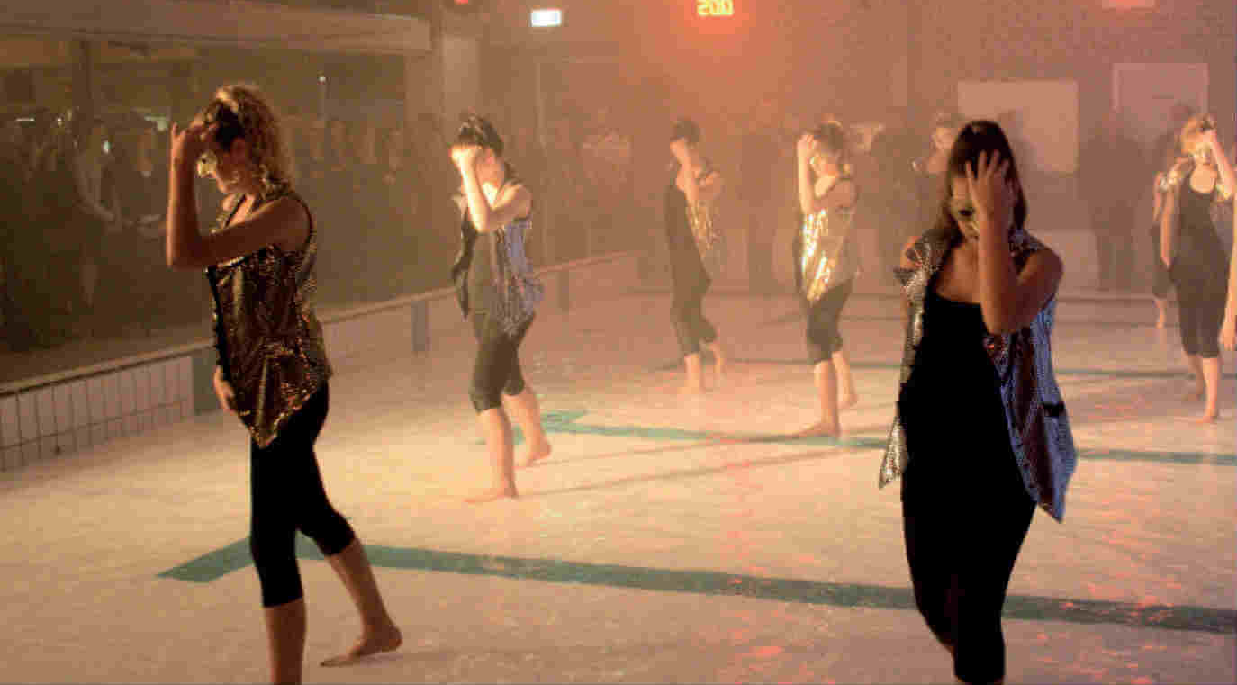

Slide 17


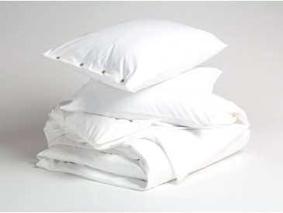


Slide 18
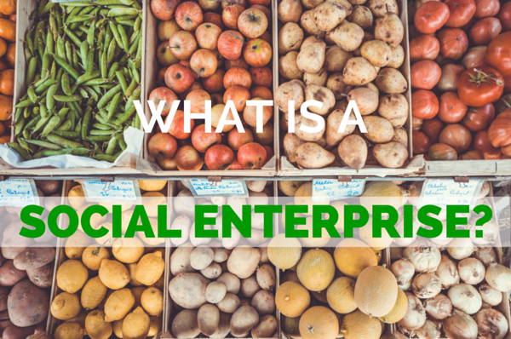
II. What makes an enterprise “social”?
What is a “social” enterprise?
For profit or not-for-profit?
Consequences of market exposure
Business models of social enterprises
More than CSR

Slide 19
The 5 dimensions of “social”
product
process
staff
clients
routine

Slide 20
Examples
product
process
staff
clients
routine
Fairphone
All
Yumeko
Cloud Cuddle
Color Kitchen

Slide 21
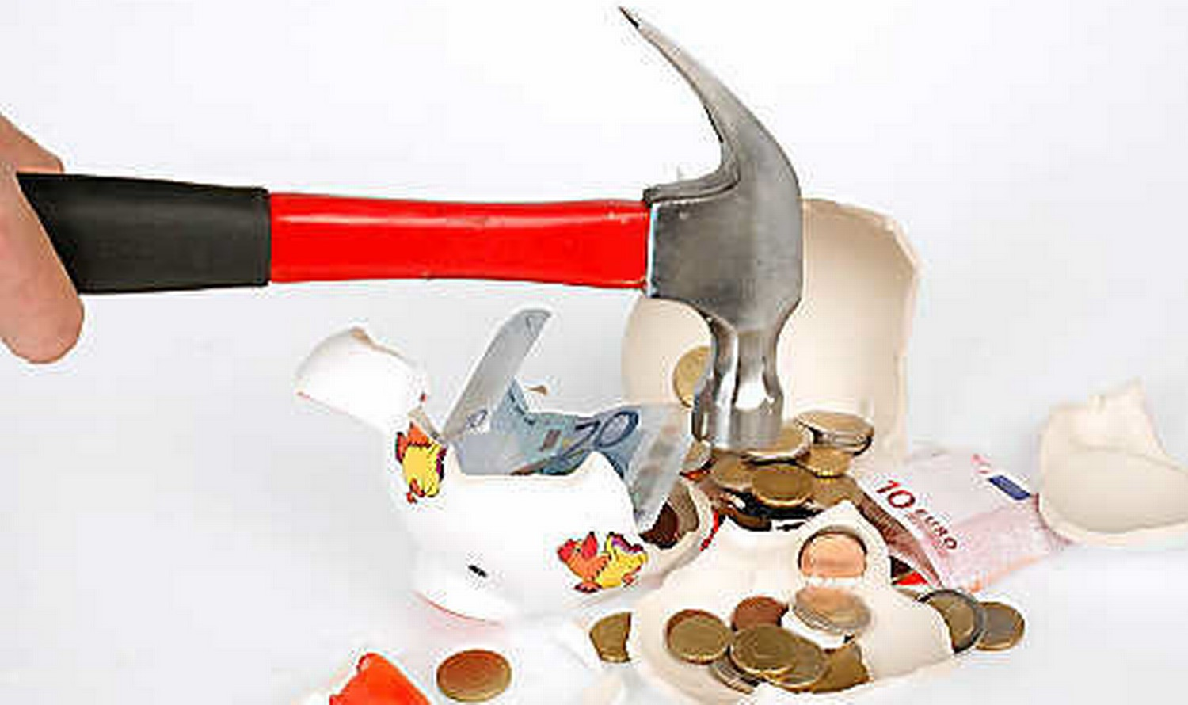
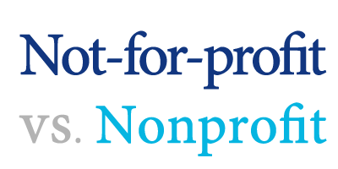

Slide 22
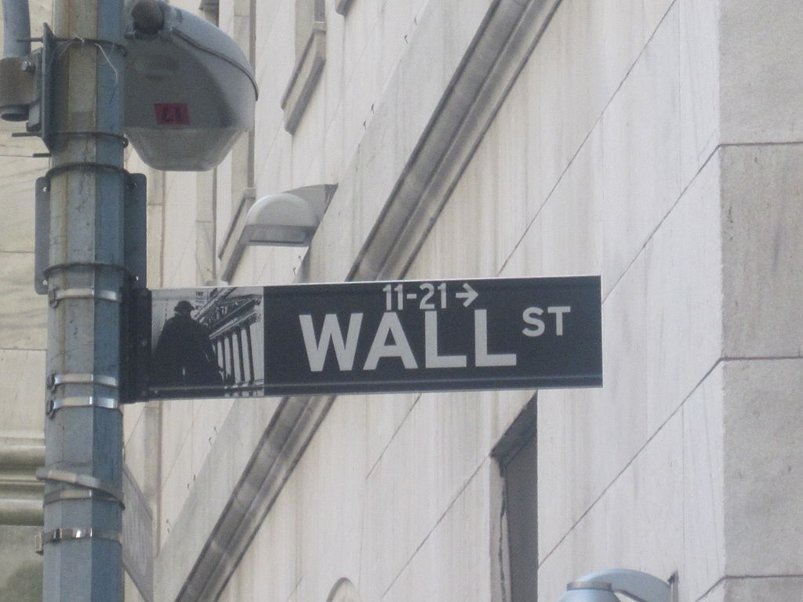
Not for individual profit

Slide 23

Social enterprises combine the best of two worlds
+
Discipline of markets
Improvement of society

Slide 24

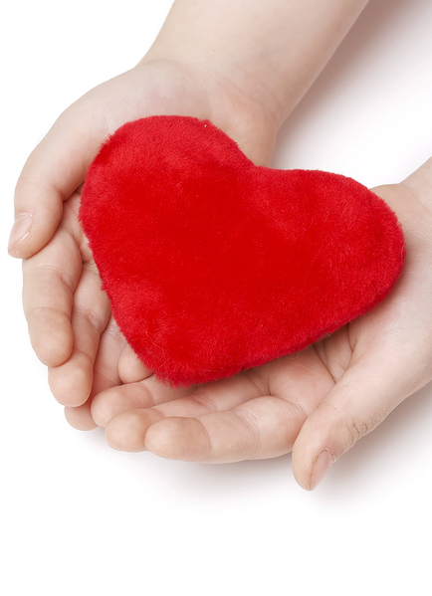

Consequences of market orientation
Customer orientation | Discipline | Innovation

Slide 25
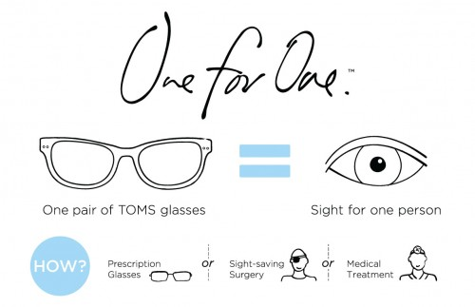
Business Models
Cross-subsidization
Economies of scale
Sympathy factor
One for One

Slide 26


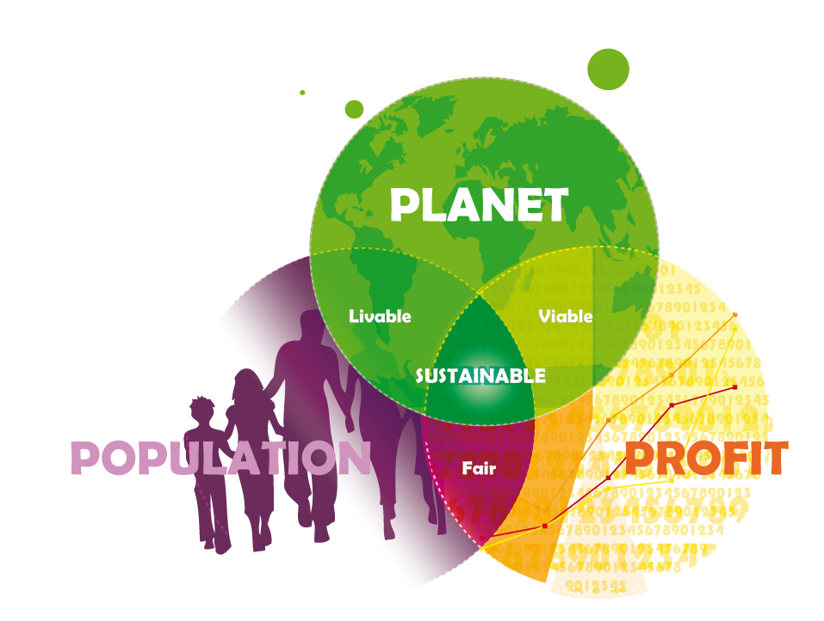
Social enterprise
CSR

Slide 27
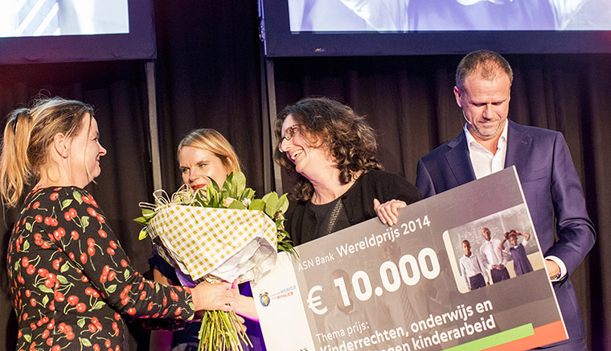
III. TODAY in Utrecht:
ASN World Award
2016

Slide 28
ASN Award
“For the World of Tomorrow”
Projects can compete in five categories:
Environment
Children Rights and Education
Security and Social Cohesion
Social Welfare
Fair Trade

Slide 29

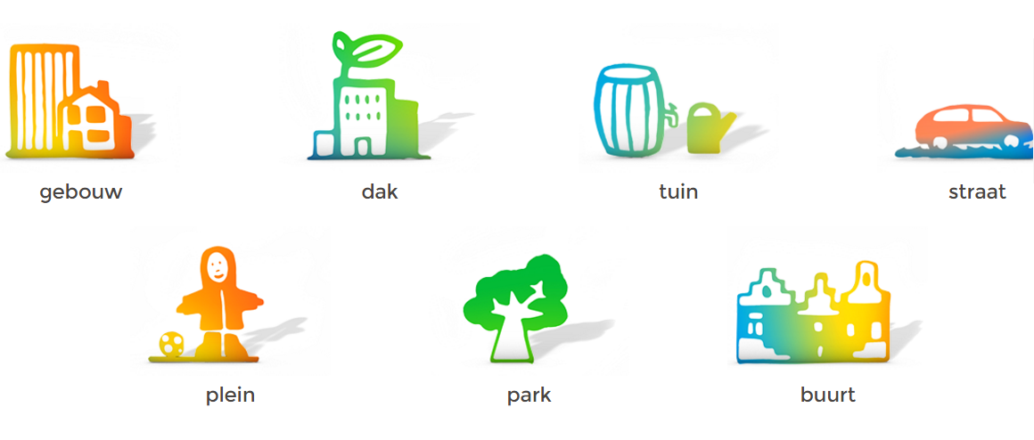
Hemels Water
(Sky water)
“No rain, no beer”

Slide 30
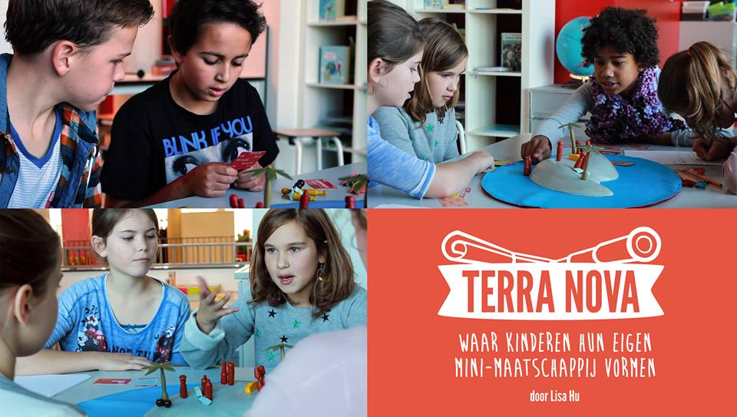
Children rights and education

Slide 31
Security and social cohesion

Slide 32
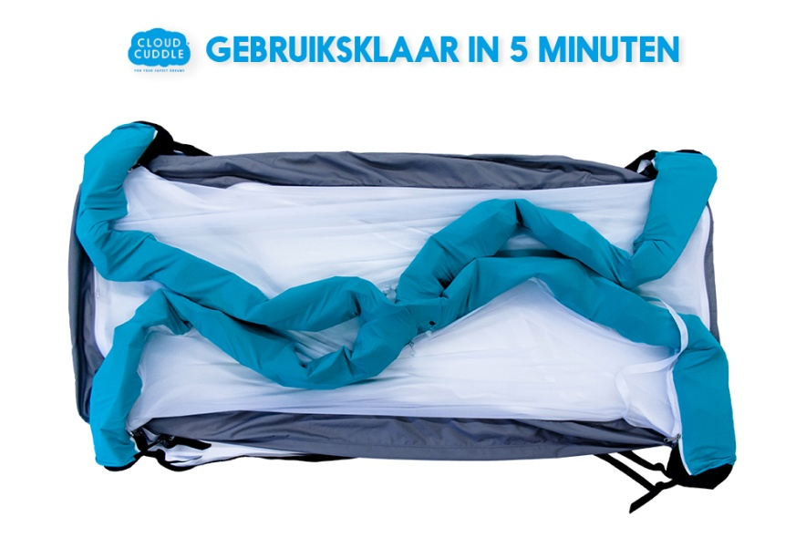

Social Welfare: Cloud Cuddle

Slide 33
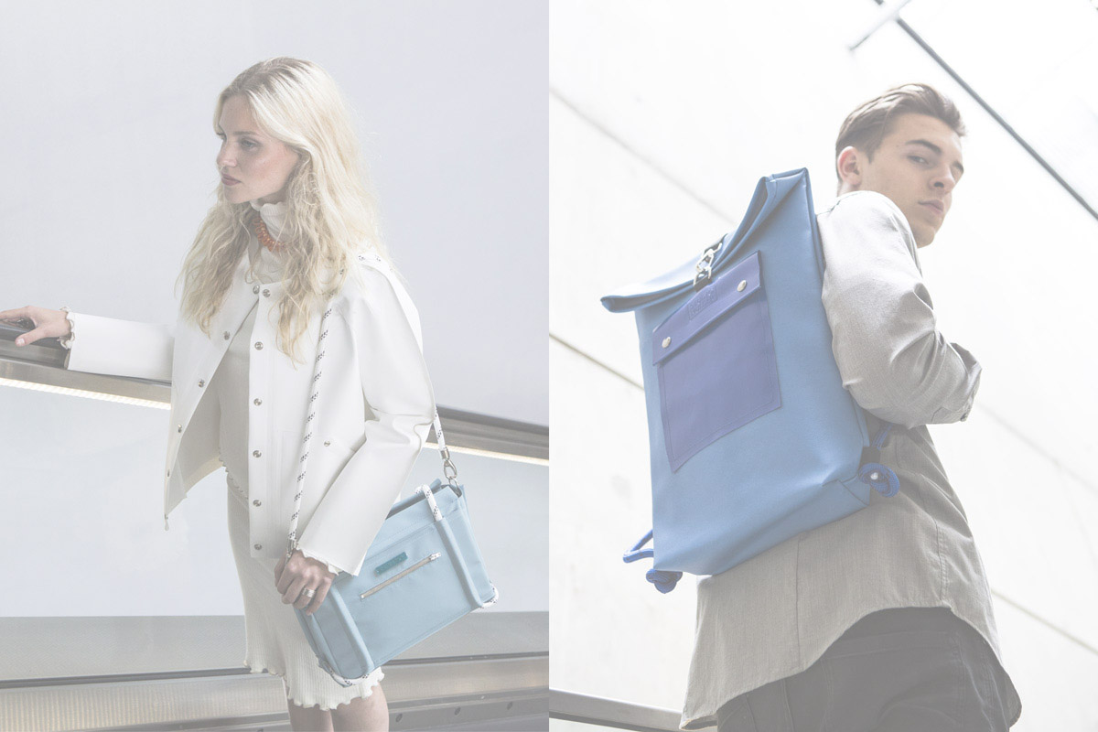
Fair trade: Synth/Ethic

Slide 34
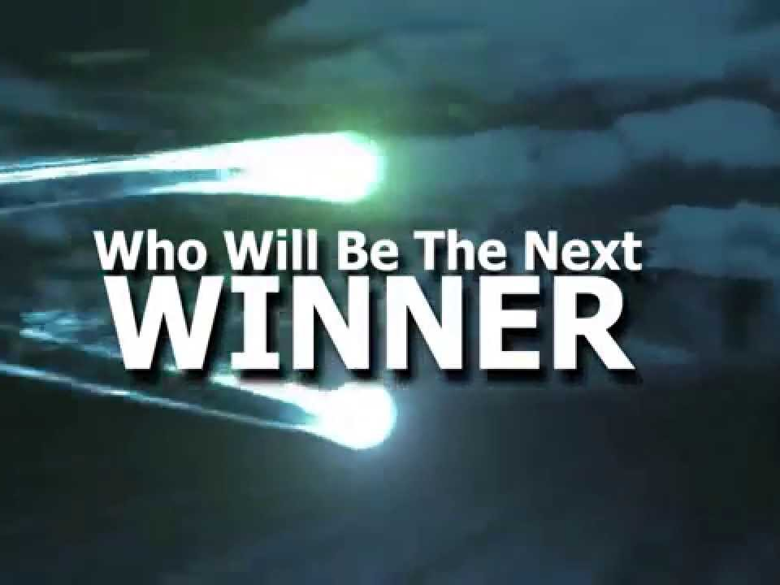
Thank you!

